Slide 1
Fair and Scalable
Online Assessment
Feedback from teachers/invigilators and Practices from other institutions
Leon Lei *^ and Crystal Luo*
* Technology-Enriched Learning Initiative
^ IEEE HK Section Education Chapter

Slide 2
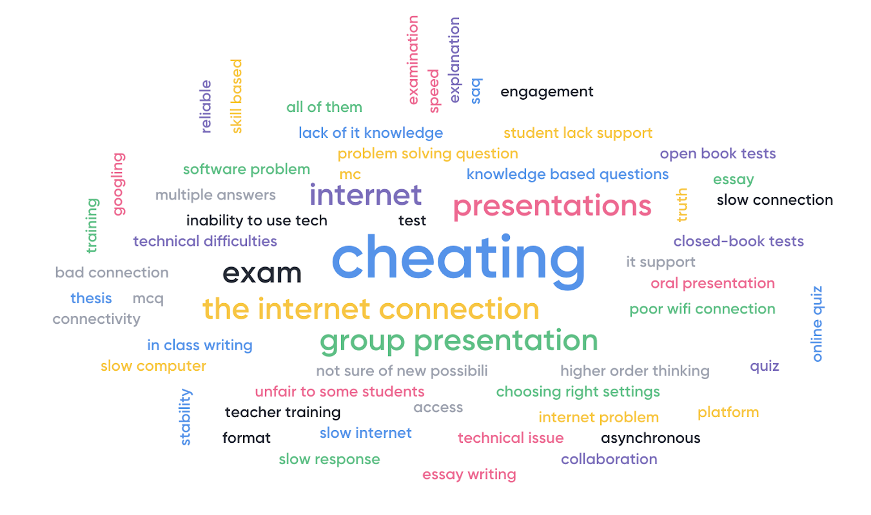
What challenges have you encountered while transfering to online assessment?
18 Mar: Webinar on online assessment (310+ participants)

Slide 3
HKU Online Examination with ITS and Exam Office
OLEX: File management (examination papers and answer files)
Zoom and Panopto: Recorded exam invigilation
  System generated Zoom sessions for proctoring
  Balance between assessment security and user friendliness
Guideline, training materials/videos (playlist) and webinars for examiners, students and invigilators

Slide 4
Teachers and students care about assessments
4/7/8 May: Webinars on OLEX / online examination
780+ teachers/invigilators with 380+ questions
940+ students with 670+ questions
Notes:
1700+ people
1000+ questions

Slide 5
Comments from teachers/invigilators
Logistics
(Before exam) Student admission
(During exam) Communication between students, invigilators and examiners
(During exam) Open book exam
(After exam) Grace period
Assessment Security
Webcam (Face, ID card)
Student screen sharing
Abnormal behaviour

Slide 6
Comments from teachers/invigilators
Technical issues
Internet connection (students/invigilators)
Internet connection (Mainland/Foreign countries)
Recording and recording arrangement
HKU Specific
Moodle arrangement
Mask wearing
Spaces in HKU

Slide 7
Online Examination of Engineering Programs: ASU
8,721 test takers with 697 incidents (ProctorU at ASU; 2016):
59% Improper answer paper submission
17% Lost connection
8% Academic integrity
9% Authentication
5% Unpermitted break
Further discussions: Maintaining Academic Integrity in Online Courses at Arizona State University

Slide 8
“Students who are working remotely, away from their familiar academic community, can feel less supported than usual.
Students who feel isolated may be more tempted to cheat.” UK QAA
Further discussions: Assessing with Integrity in Digital Delivery,
UK Quality Assurance Agency for Higher Education

Slide 9
Assessing with Integrity in Digital Delivery (UK)
(Pedagogy) Discuss the risks of engaging with contract cheating services
(Community) Develop internal networks of academic integrity support
(Technology) Adopt technologies to support the detection of cheating
(Community) Understand student's location can have an impact on students' ability to undertake online assessment
Further discussions: Assessing with Integrity in Digital Delivery
UK Quality Assurance Agency for Higher Education

Slide 10
Assessing with Integrity in Digital Delivery (US)
(Pedagogy) Require abstracts with writing assignments
(Pedagogy) Require drafts of papers before the final version is due
(Pedagogy) Share their thoughts on the academic integrity policy
(Technology) Randomize test questions and answers
More examples: 46 strategies to promote academic integrity and
Strategies to address academic integrity (Video), ASU

Slide 11
No “ready-to-serve” tech solutions for exam
Difficult to read and answer on the computer
Technical issues (e.g. sudden logout, auto-save function crash)
We need multi-stage pilot testing and adoption before the next incident

Slide 12
TDG: Proctoring Technologies for Examinations
To understand the benefits, costs and limitations of different online test/exam/assessment proctoring mechanisms, in relations to the unique environment in the University
To develop procedures and training resources for online proctored test/exam design
2020 Cohort 1 (Pending)

Slide 13
Assessment Beyond the Examination
Public, individual or group performances are unable to take place
Laboratory-based assessment
Further discussions: COVID-19: Thematic Guidance - Practice and Lab-Based Assessment, UK Quality Assurance Agency for Higher Education

