Slide 1
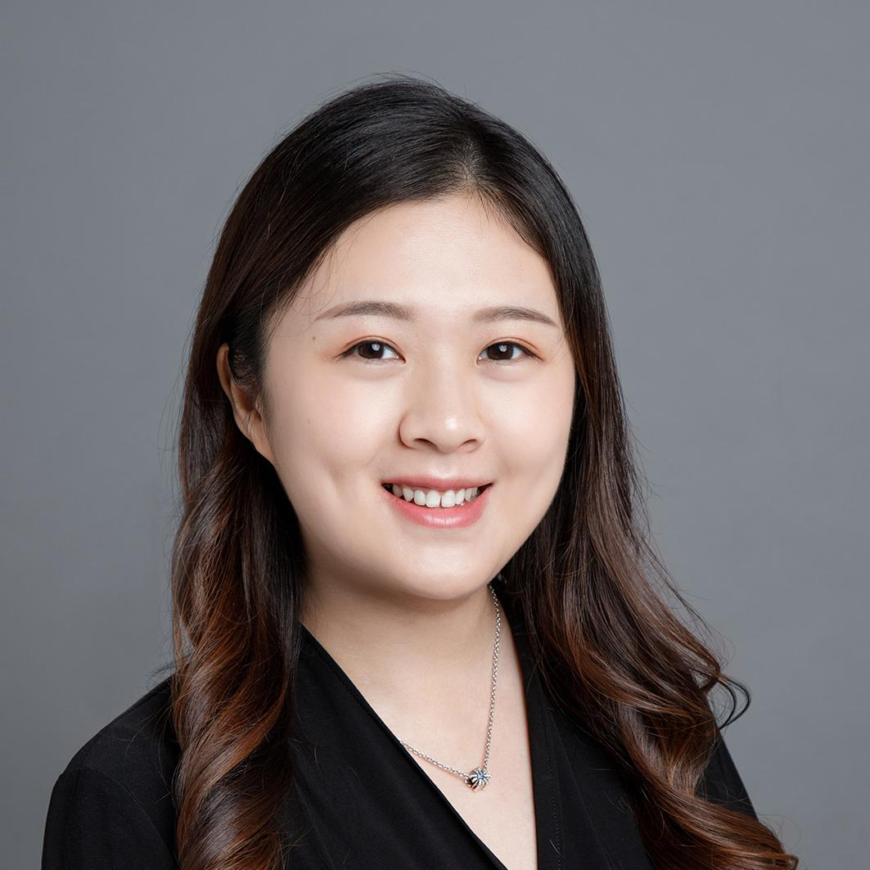
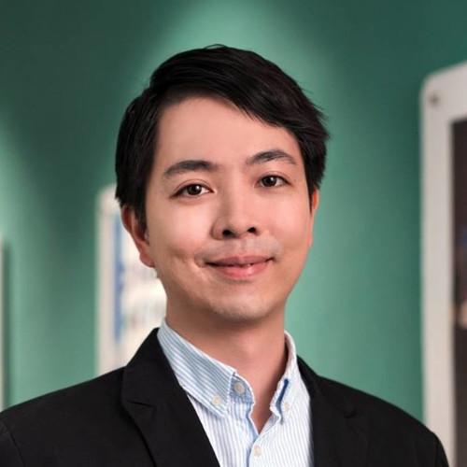
Frameworks for Online Assessment
Link to the slide: bit.ly/OnlineAssessmentFramework
Ms. Crystal Luo
crystal@teli.hku.hk
Technology-Enriched Learning Initiative
Dr. Leon Lei
culei@teli.hku.hk
Technology-Enriched Learning Initiative

Slide 2
In the next 10 mins...
HKU Experience: From F2F to Online Assessment
Comments and Concerns from Students
Insights and Suggestions

Slide 3
From Face-to-face Assessment
to
Online Assessment
Link to the slide: bit.ly/OnlineAssessmentFramework

Slide 4
Allowed to access resource
Previous setting
Oral Test
(e.g. presentation)
Third party involved
(e.g. field trip)
Hands-on Test
(e.g. lab)
Autonomously Testing
(e.g. essay, project)
F2F
Online
Teacher’s Interaction required
(e.g. clinical skill testing)
Autonomously testing
(e.g. close book test)
Restricted to access resource
Full Version: How to Transfer to Online Assessment

Slide 5
Allowed to access resource
Online Assessment
Autonomously Testing
(e.g. essay, project)
Moodle/
Turnitin
Third party involved
(e.g. field trip)
Oral Test
(e.g. presentation)
Zoom/
Video filming + Moodle
Hands-on Test
(cannot lend equipment,
e.g. chemistry lab)
Hands-on Test
(can lend equipment,
e.g. hardware lab)
Zoom/
Video filming + Moodle
F2F
Online
Teacher’s Interaction required
(e.g. clinical skill testing)
Teacher’s Interaction required
(e.g. consulting skill testing)
Zoom/
Video filming + Moodle
Autonomously testing
(e.g. close book test)
Proctoring
(OLEX + Zoom)
Restricted to access resource
Full Version: How to Transfer to Online Assessment

Slide 6
Allowed to access resource
Online Assessment
Autonomously Testing
(e.g. essay, project)
Moodle/
Turnitin
Third party involved
(e.g. field trip)
Oral Test
(e.g. presentation)
Zoom/
Video filming + Moodle
Hands-on Test
(cannot lend equipment,
e.g. chemistry lab)
Hands-on Test
(can lend equipment,
e.g. hardware lab)
Zoom/
Video filming + Moodle
F2F
Online
Teacher’s Interaction required
(e.g. clinical skill testing)
Teacher’s Interaction required
(e.g. consulting skill testing)
Zoom/
Video filming + Moodle
Autonomously testing
(e.g. close book test)
Proctoring
(OLEX + Zoom)
Restricted to access resource
Full Version: How to Transfer to Online Assessment

Slide 7
Comments and Concerns
From Students
Link to the slide: bit.ly/OnlineAssessmentFramework

Slide 8
Students care (a lot) about assessments
April: Survey on Study Concerns Arising from the Switch to Online Learning (AAO)
  843 comments

Slide 9
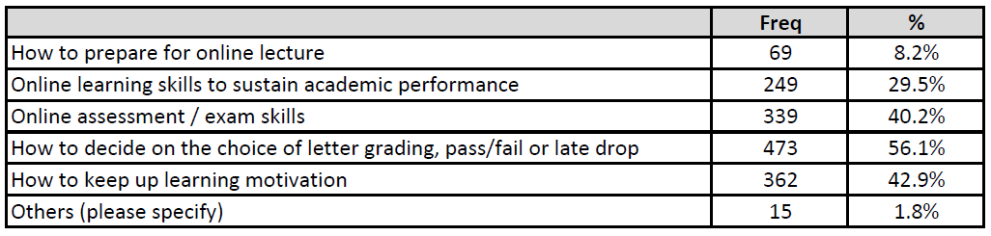
Student Survey on Advising Needs (AAO)
Is there anything that you wish to consult an adviser due to the switch to online teaching this semester? (843 replies - April)
Group projects (Letter grade or Pass/Fail), internship, exchange, PG studies...

Slide 10
Students care (a lot) about assessments
April: Survey on Study Concerns Arising from the Switch to Online Learning (AAO)
  843 comments
4/7/8 May: Webinars on OLEX / online examination (Students)
  941 participants
  674 questions

Slide 11
- Technical
Difficulties
- Privacy
Concerns

Slide 12
Unfairness - Technical Difficulties
Unstable internet
Malfunctional device: computer, webcam, etc.
Venue (e.g. home) is not quiet enough or big enough (e.g. no long table for proctoring)
Notes:
Students think that the following difficulties will waste their time and energy during the online examination, and hence, it’s unfair to them:

Slide 13
“When we do handwriting exam, we cannot pay attention to the camera, hence, we may not find ourselves lose the connect when the network goes wrong….”
“If I need to keep an eye on the my internet connection, I cannot fully focus on my exam…”
“I don’t have a big enough table that meets the requirements...”
- students comments

Slide 14
Privacy Concerns
Students have concerns about the proctoring recording

Slide 15
“Where will the recording video be stored? For how long? And will it be password encrypted?
“Can participants see each other’s home in the zoom meeting?”
- students comments

Slide 16
Insights
and
Suggestions
Link to the slide: bit.ly/OnlineAssessmentFramework

Slide 17
Insights and Suggestions
Technical Difficulties
(1) University provides facilities
(2) More flexible arrangement
2. Privacy Concerns
            (1) All data will be stored at HKU server
Notes:
Teacher’s effort

Slide 18
Hints of Mitigating Cheating
Be more Creative
Notes:
Teacher’s effort

Slide 19
Hints of Mitigating Cheating
(1) Paradigm shifting
- Focus more on higher order thinking tests
Notes:
Teacher’s effort

Slide 20
Allowed to access resource
Online Assessment
Autonomously Testing
(e.g. essay, project)
Moodle/
Turnitin
Third party involved
(e.g. field trip)
Oral Test
(e.g. presentation)
Zoom/
Video filming + Moodle
Hands-on Test
(cannot lend equipment,
e.g. chemistry lab)
Hands-on Test
(can lend equipment,
e.g. hardware lab)
Zoom/
Video filming + Moodle
F2F
Online
Teacher’s Interaction required
(e.g. clinical skill testing)
Teacher’s Interaction required
(e.g. consulting skill testing)
Zoom/
Video filming + Moodle
Autonomously testing
(e.g. close book test)
Proctoring
(OLEX + Zoom)
Restricted to access resource
Full Version: How to Transfer to Online Assessment

Slide 21
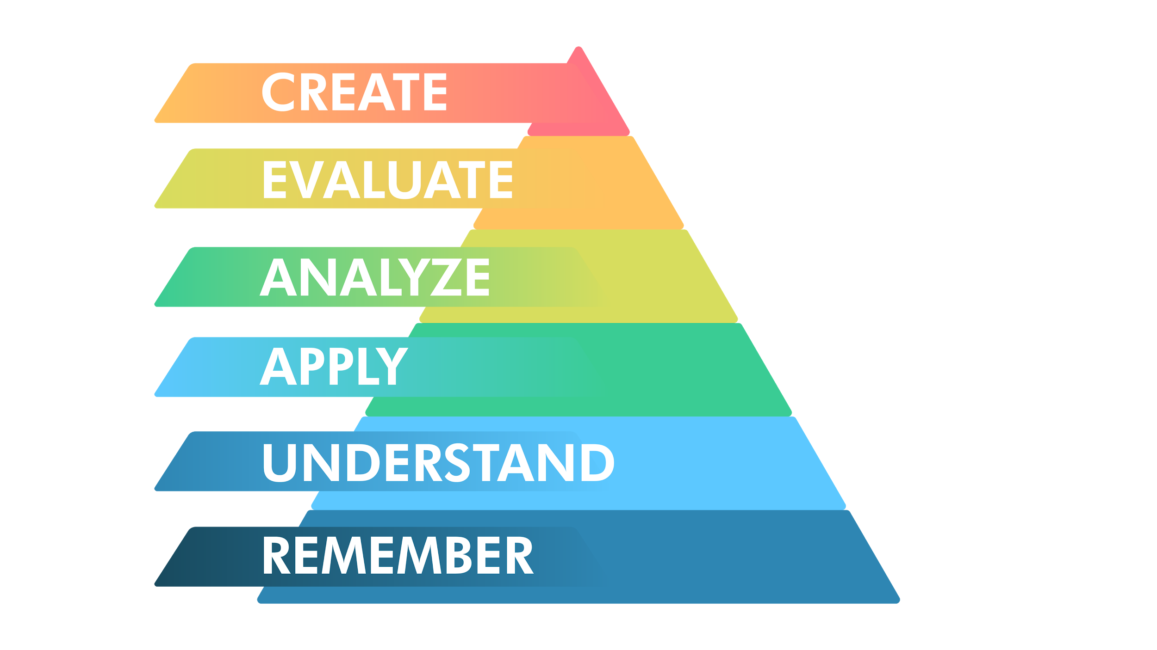
Hints of Mitigating Cheating
(1) Paradigm shifting
- Focus more on higher order thinking tests
Open book
Close book
Notes:
Teacher’s effort

Slide 22
Hints of Mitigating Cheating
(1) Paradigm shifting
- Focus more on higher order thinking tests
- Create questions that are not 'Google-able'
(2) Difficult to just copy answers
- Shuffle questions, options
- More questions
(3) Time-consuming to copy online
- More questions
Notes:
Teacher’s effort

Slide 23
Allowed to access resource
Online Assessment
Autonomously Testing
(e.g. essay, project)
Moodle/
Turnitin
Third party involved
(e.g. field trip)
Oral Test
(e.g. presentation)
Zoom/
Video filming + Moodle
Hands-on Test
(cannot lend equipment,
e.g. chemistry lab)
Hands-on Test
(can lend equipment,
e.g. hardware lab)
Zoom/
Video filming + Moodle
F2F
Online
Teacher’s Interaction required
(e.g. clinical skill testing)
Teacher’s Interaction required
(e.g. consulting skill testing)
Zoom/
Video filming + Moodle
Autonomously testing
(e.g. close book test)
Proctoring
(OLEX + Zoom)
Restricted to access resource
Full Version: How to Transfer to Online Assessment

Slide 24
For further questions:
Ms. Crystal Luo
crystal@teli.hku.hk
Technology-Enriched Learning Initiative
Dr. Leon Lei
culei@teli.hku.hk
Technology-Enriched Learning Initiative

