Slide 1

Authentic Digital Assessment
Gina Marchetti (Arts)
Half-Day Virtual Forum: Online T&L 2019-2020: The HKU Experience
Monday, May 11, 2020

Slide 2
Moving Continuous Assessment Online
Campus-based
Online version
In-class writing
  Closed book
  Time bound
  Proctored
Group presentations
  Tutorial time for group work
  Opportunities to meet on campus
Participation (discussion, debates, quizzes, etc.)
  Face-to-Face
  Polling or other online tools used in class
Writing at home
  Open book
  Fewer time restrictions
  Temptation to plagiarize or make use of unauthorized help
Option for individual assignments/other modifications
Participation
  Synchronous (via Zoom)
  Asynchronous (discussion board on Moodle or other platform)
  Polling/quizzes online

Slide 3


The Role of Massive Open Online Courses (MOOCs)
Hong Kong Cinema through a Global Lens MOOC
  CCGL9001 Hong Kong Cinema through a Global Lens (Fall 2019)
  HIST2031 History through Film (Spring 2020)
  English classes at Li Po Chun United World College of Hong Kong (2020)
Doing Gender and Why It Matters MOOC
CCHU9039 Sexuality and Culture

Slide 4
Use of MOOC to supplement and flip on-campus courses
Forum discussion for expanded conversations with learners beyond Hong Kong including partnerships with teachers at other institutions
Use of video lectures in flipped classes
Video lecture material used by students to review course material
Optional use of MCQs to check basic knowledge and occasional use of peer assessments to prepare for graded on-campus assignments
Use of round up videos for weekly summary/expansion of in-class and online conversations
Easy access to supplementary materials such as additional online resources, interviews, demonstrations, video clips, etc.
Links to social media (Facebook and Twitter) through the MOOC

Slide 5
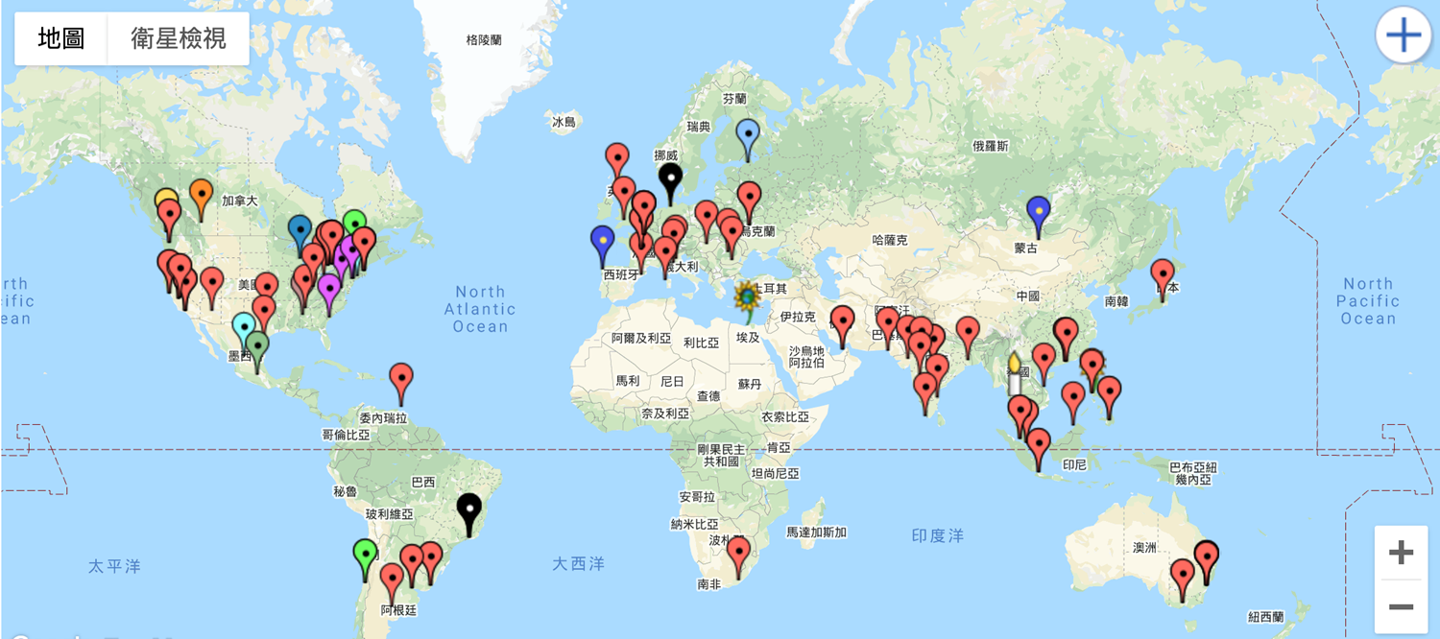
Geographic diversity

Slide 6
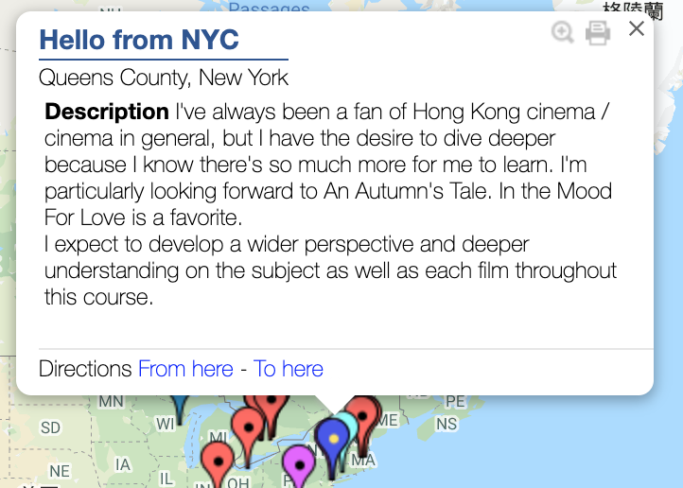
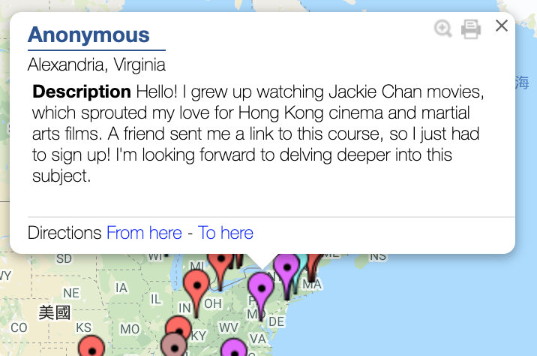
International learners on the MOOC platform

Slide 7
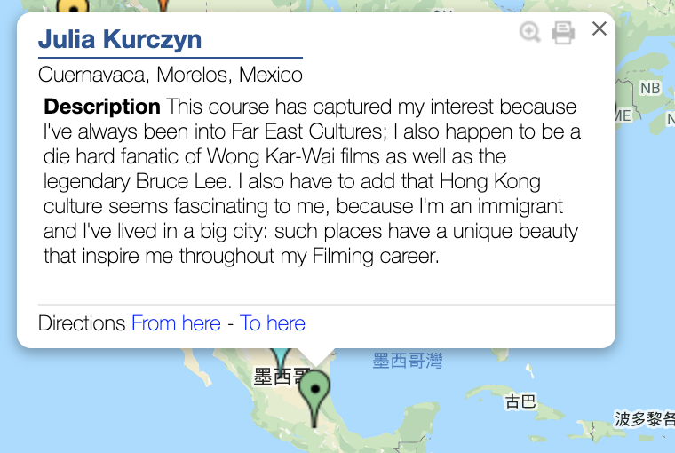
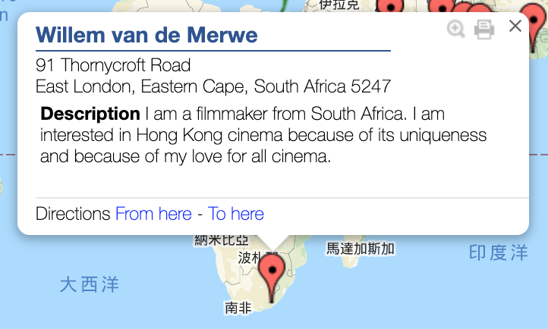
Selected introductions

Slide 8
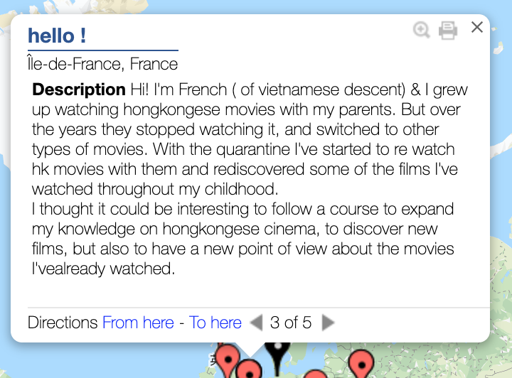
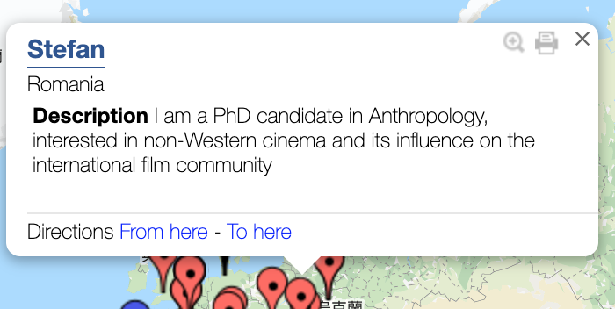
Selected introductions

Slide 9
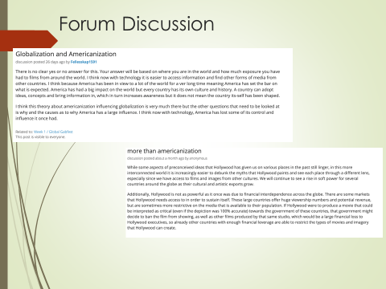
Between Zoom and MOOC discussions— “I do think that students were more inclined to speak up in Zoom chats because they’d been sharing insights on the MOOC forum chat.”
HIST2031 “…for Zoom…I like it and find it quite easy to use but I do fear that it presents certain problems in terms of inclusion. I had some success by using the text chat. In several sessions, when students came to class, I had them sign in and share opinions about a question or a film and that became a bit of an ice breaker. But I fear that there were several students who simply remained quiet because it was easier. (However, in the history and film course I do think that students were more inclined to speak up in Zoom chats because they’d been sharing insights on the MOOC forum chat.)

Slide 10
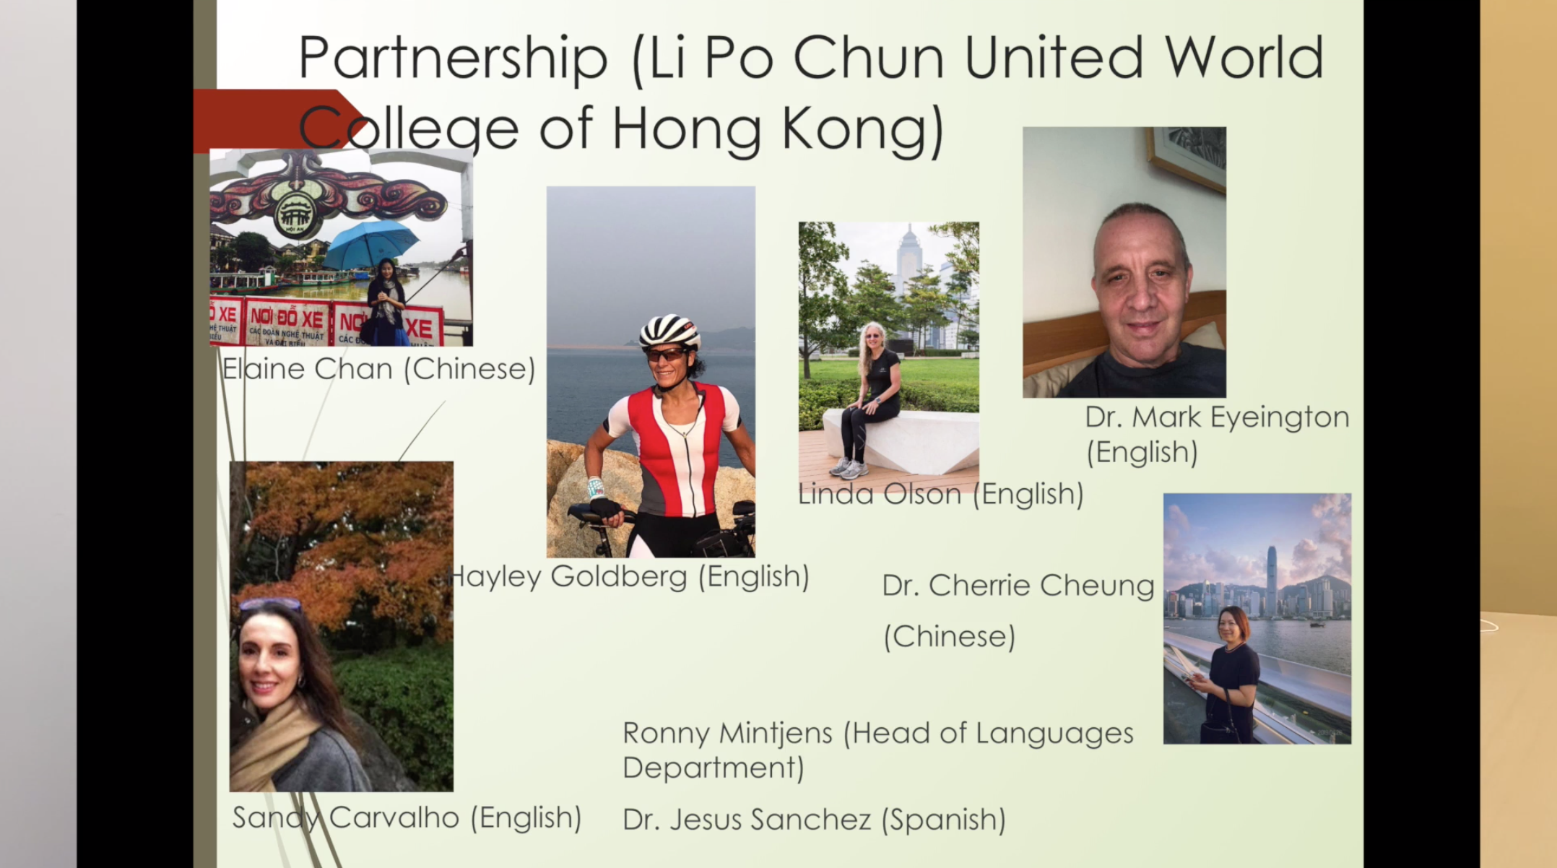
Li Po Chun United World College of Hong Kong

Slide 11
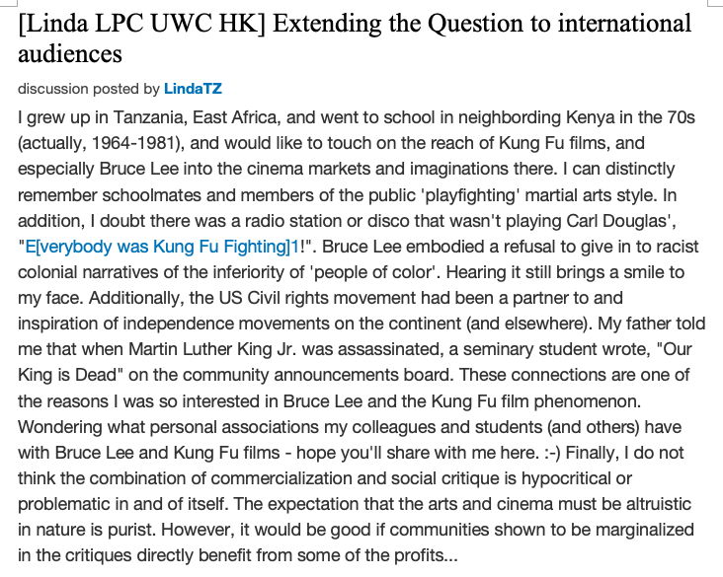

“Wondering what personal associations my colleagues and students (and others) have with Bruce Lee and Kung Fu films—hope you’ll share with me here..”

Slide 12

From the Li Po Chun United World College students
“What I enjoyed the most were the discussions we had after the videos. It was very nice to see all the comments of my classmates.”
“Being someone who values and loves class discussions, I was not completely sure if I would find an online course engaging and interesting. To my surprise, I did not only find it extremely engaging due to the interviews and ‘food for thought’ discussions where I could read the opinions of my peers and contribute my own perspective but I also learnt many things regarding Hong Kong Cinema.”
“I was a bit critical in the beginning about the whole idea of participating in the course, which takes place online and we have to do the assessments.
However, this moment the only thing I left to say is “thank you”. “Thank you” for all the knowledge you gave us, especially taking into consideration, that knowledge is invaluable. Thank you for your great support and sharing!”

Slide 13
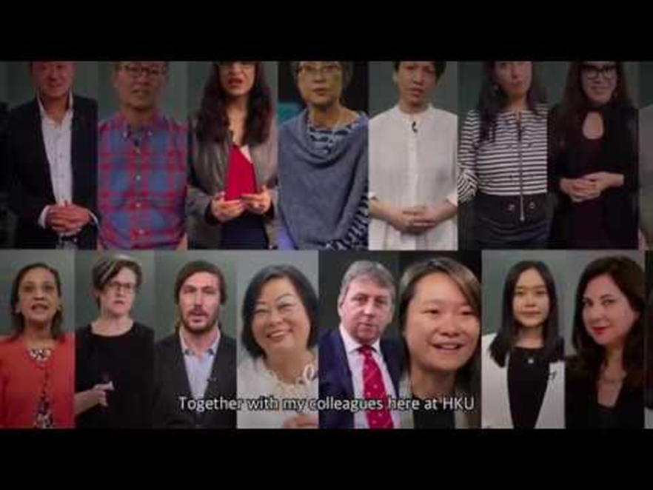
Comments from CCHU9039 Sexuality and Culture—MOOC vs. Panopto
“Regarding the MOOC experience, so far I am enjoying all the videos and mini quizzes in every module because the videos are short but giving us so much information on different topics. Comparing to real-time video teaching, I would prefer the current teaching mode (MOOC) because it provides more flexibility on our schedules and we can grasp the contents when we are ready to learn.”

Slide 14

MOOC vs. Zoom
“Turning to MOOC, I found it really useful compared with any other existing forms. I’ve experienced ZOOM conference, but honestly it is not efficient and can easily waste everyone’s time. Because we may interact during the class and technical problem emerges randomly, little useful knowledge is presented. I really prefer records because we can watch it many times and learn it alone. Compared with Panopto, MOOC is also better cuz it have captions and quiz.”

Slide 15
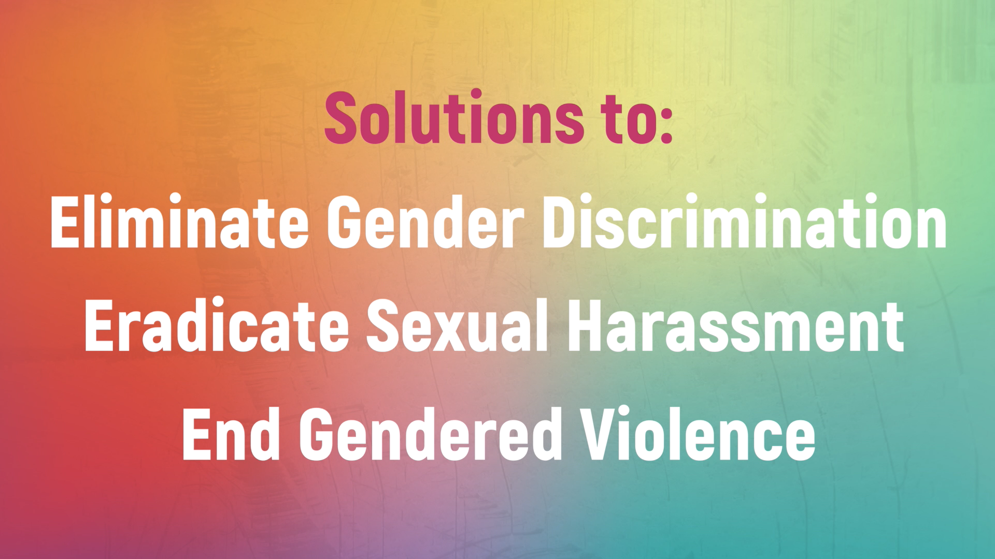
On embedded quizzes in the MOOC
“The MOOC experience was fine because I was able to read the script of the lecturer so that it is easier for me to follow the online lecture. Also, it was flexible for students to learn as I could stop or replay the online lecture videos when I found something important or something I did not understand. So, I could search for the information online during the middle of the lecture. When I was doing the quiz, I was able to refer to the information provided in the online lectures and finish the tasks.”
“In terms of the MOOC experience, I found it useful to have included a variety of speakers and the multiple choices questions under each chapter to reiterate the content. It is also a user-friendly learning platform.”
“It is very unfortunate that the classes have to change to online teaching due to the virus. However, after the first experience from the MOOC system, I feel MOOC is a very good and useful tool that helps me with online learning. The videos are interesting and easy to understand. The short and clear sections of the three topics also allow me to have a better understanding of the three main topics. Moreover, the questions for each section also allow me to analyze the whole video so that I can have a deeper impression of the content. Also, the mini quiz further helps me to understand and summarize all three topics from week 5 “The Dark Side...”

Slide 16
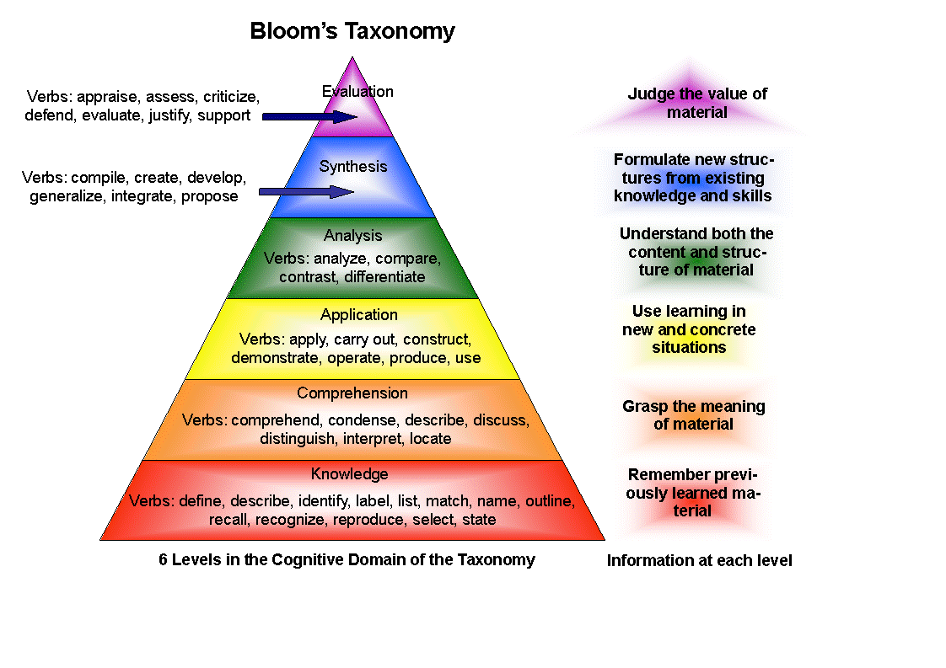
Upside of Assessing Online Participation
Video and/or written record of remarks
Polls/quizzes mark a degree of engagement
Synchronous meetings offer more than one avenue for engagement
  Chat—directed and group
  Breakout rooms
  Choice of video or audio only for verbal questions
Asynchronous discussion boards
  Open to wider range of learners—instructor able to use that to expand conversation
  Convenience of engaging at time chosen by instructor
  Opportunity to reflect on material before engaging
Thanks to CETL for graphic

Slide 17
Observations
Online learning strongly driven by outcomes and assessments
Not all types of assessments move easily online
Not all distance education is online education
AND not all online education takes place at a distance
Students and instructors differ in their preferences for synchronous (Zoom) and asynchronous (Panopto) modes of online instruction
Teachers and students may need to use a range of online platforms for best results
Students may be “digital natives” but most are new to online education/distance learning
Most teachers make routine use of online instructional tools (HKU’s LMS-Moodle) and some are familiar with flipped classes, gamification, MOOCs, polling/quiz tools such as Mentimeter and Kahoot

Slide 18
Recommendations
For students
  Learning with online tools part of orientation to university life
  Ethics discussion expanded beyond academic dishonesty to include online/in-class behavior (gender/diversity training with discussion of online harassment)
For teachers
  Encouragement to make online pedagogy a part of their planning for all courses
  Funding for increasing number of flipped, hybrid, and fully online offerings
For administrators
  Planning for online education beyond the crisis
    Recognition of role the digital plays in expanding international, inter-institutional, and community involvement
    Preparation for changing educational and professional environment in which online learning becomes increasingly important during and beyond undergraduate programs

