Slide 1

Assessment
Beyond Curriculum
Experience from Nursing
Dr Janet Wong
Associate Professor, School of Nursing
LKS Faculty of Medicine
The University of Hong Kong

Slide 2



Problems and Issues
We have 200+ students waiting for graduation and join nursing workforce!
No practicum
is allowed
COVID-19

Slide 3
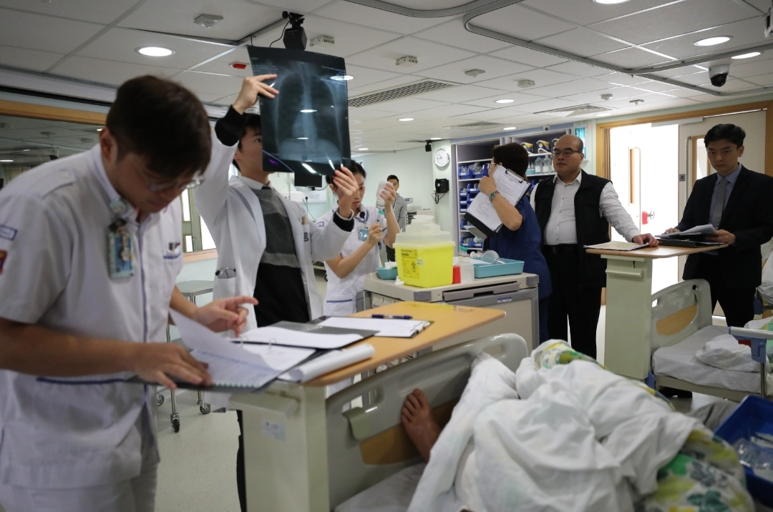
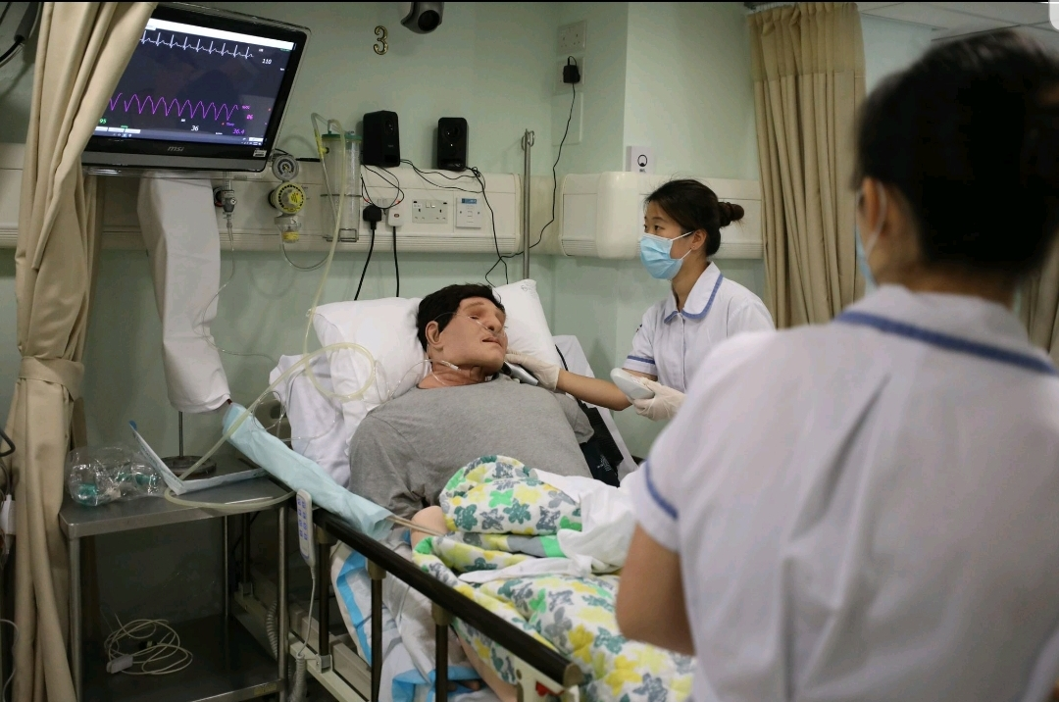
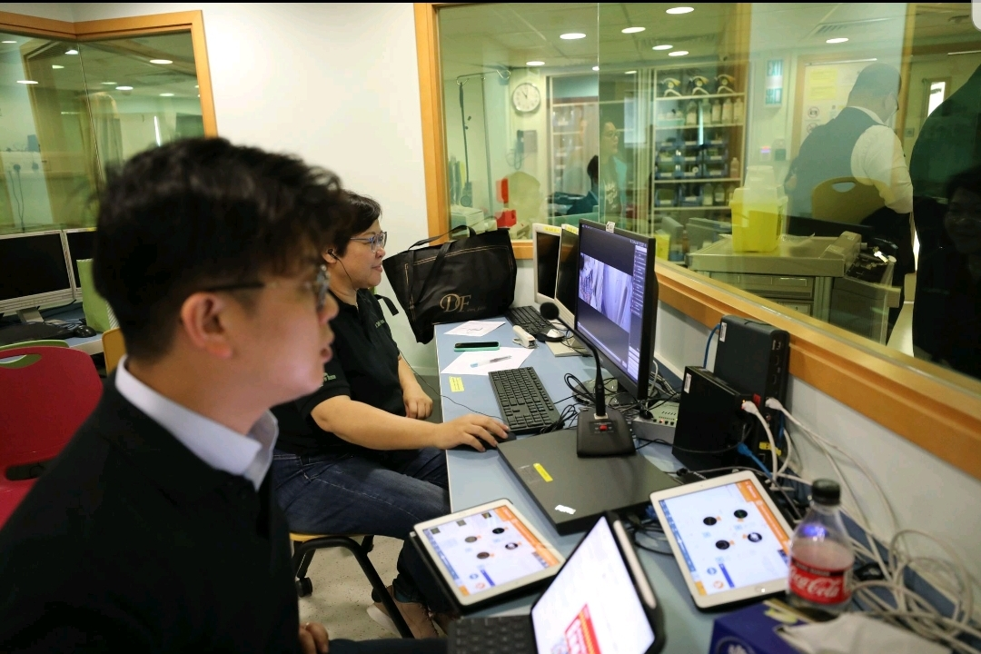
Mannequin-based simulation

Slide 4
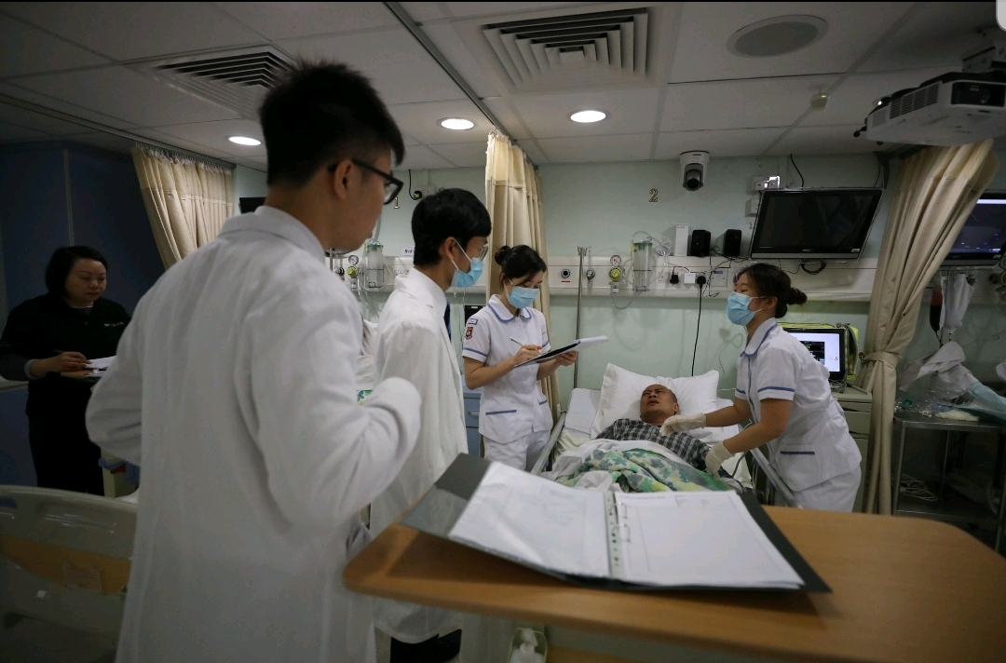
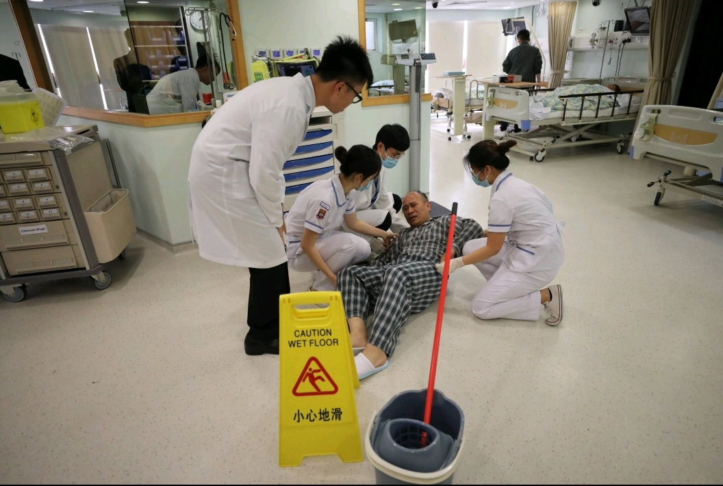
Patient-based simulation
Reducing clinical error
Improving the safety and quality of health care

Slide 5
Evaluation
Teamwork
Critical thinking
Student satisfaction

Slide 6

Virtual Simulation

Slide 7
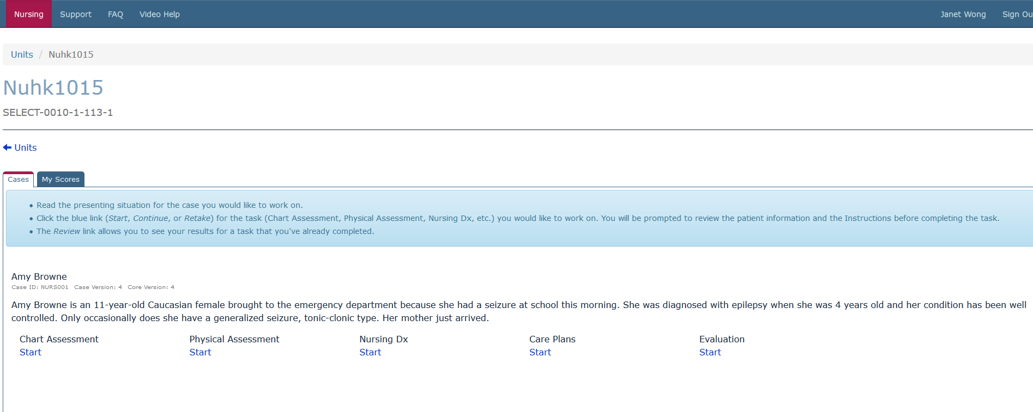

Slide 8
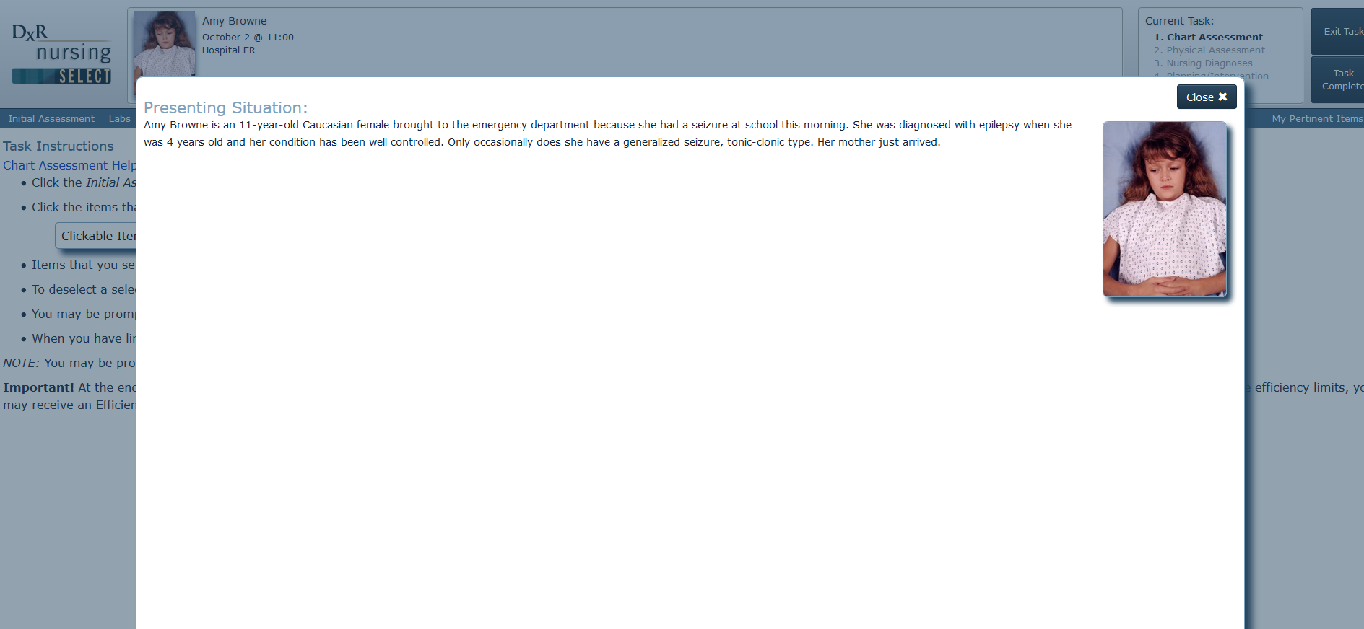

Slide 9
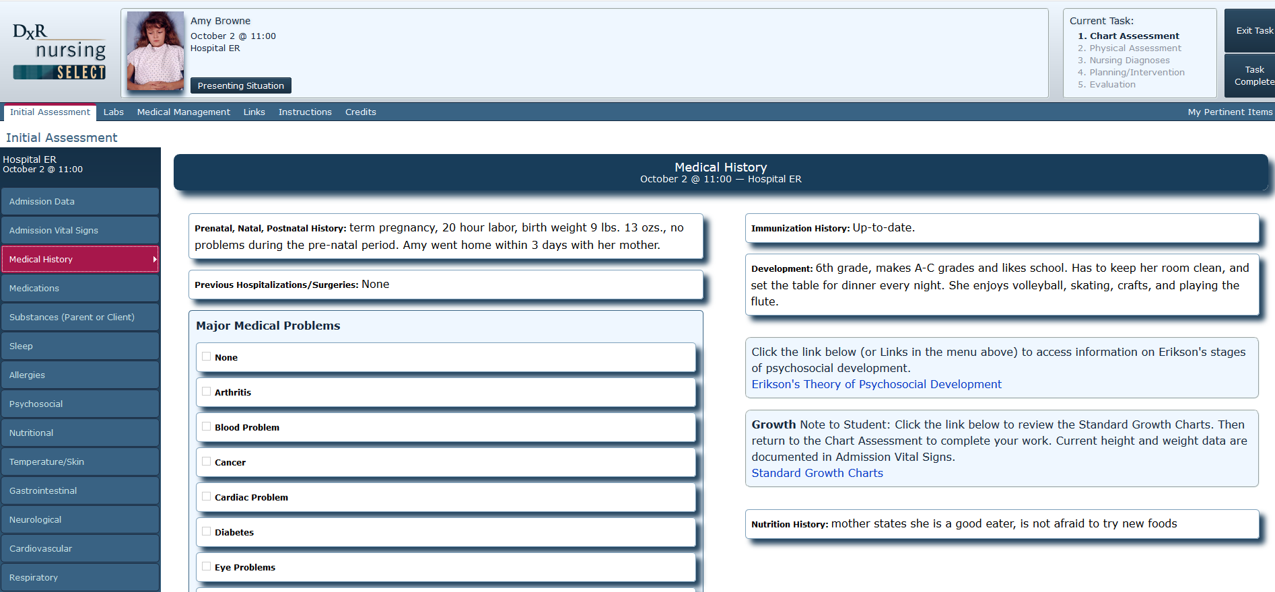

Slide 10
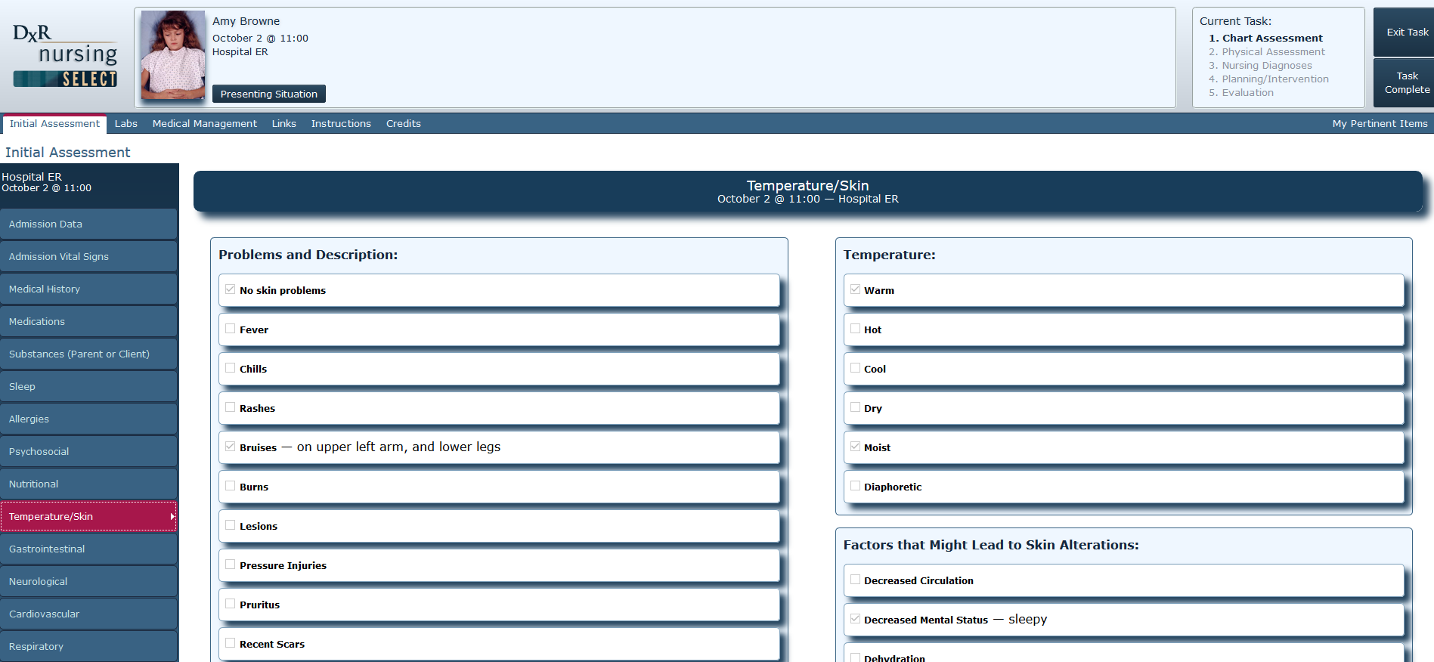

Slide 11
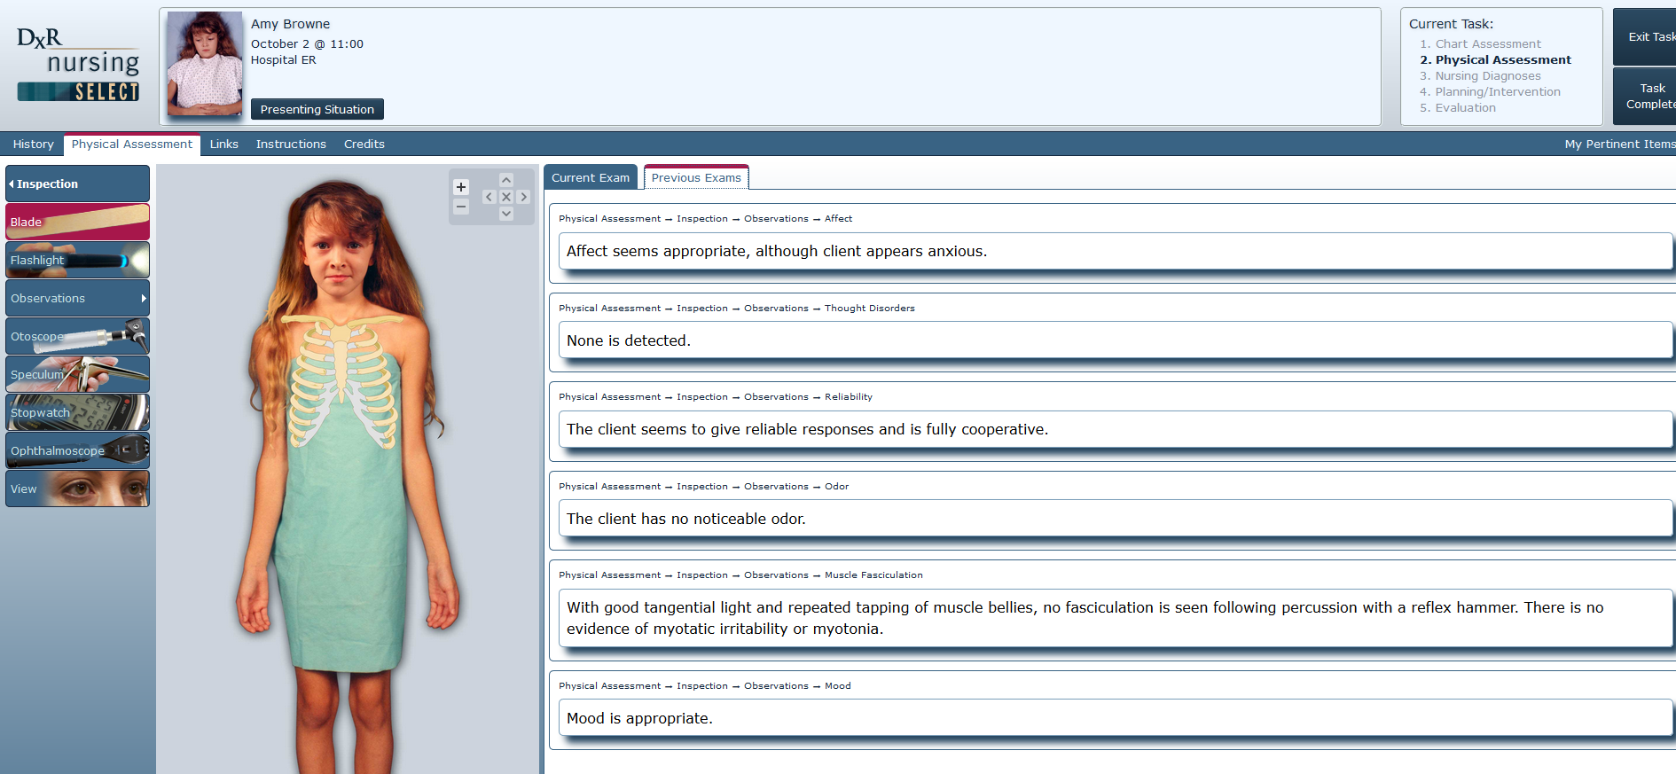

Slide 12
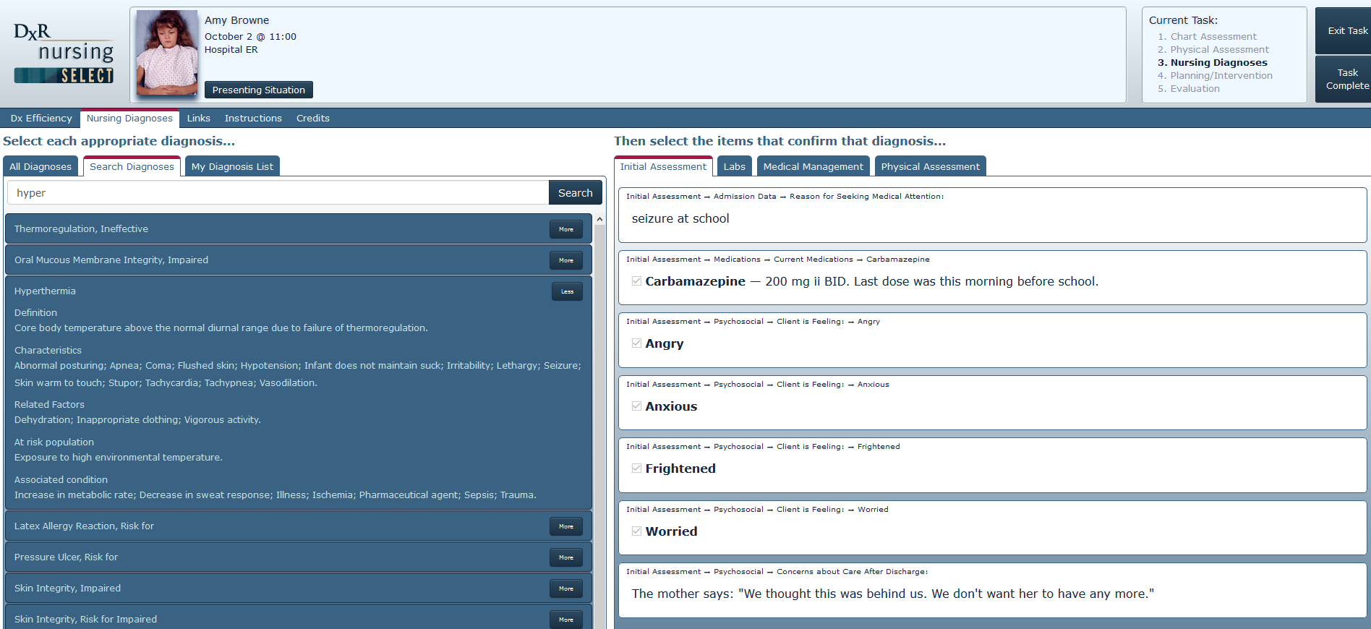

Slide 13
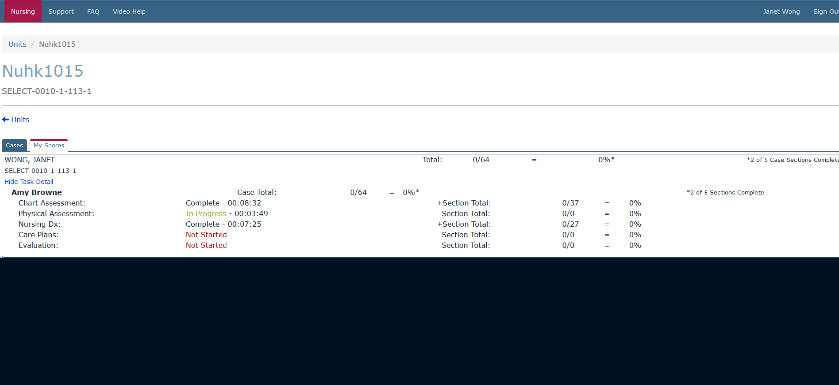

Slide 14
Online debriefing via Zoom
To facilitate processes of reflection after the learning experience
To recapture the learning objectives
To allow questions from students
Use the three-dimensional (3D) model of debriefing:
  Defusing
  Discovery
  Deepening
  (Zigmont et al, 2011)

Slide 15
3D model of debriefing
Zoom Chat Room
Defusing
Discovery
Deepening
To encourage emotional ventilation and clarification of the events
To identify learning gaps by analyzing the performance
To relate lessons from the simulation and summarize what have been learnt
(Zigmont et al, 2011)

Slide 16
Assessment is…
a learning process
Teachers: to adjust their teaching strategies
Students: to adjust their learning strategies

Slide 17
What have been learnt?
Virtual simulation
Maintain realism by using clinical scenarios
Have a high level of interactivity
Being accessible anytime and anywhere
Provide instant feedback containing rationales
Can further modify as a game to enhance enjoyment

Slide 18
Solve problems in mannequin/patient-based simulation
Only allow small number of students at one time
Need to run repeated sessions
Need to consider availability of simulation facilities
Need to consider scheduling issues

Slide 19
More to come….
Gamification
Telehealth

Slide 20
Questions?
Welcome

