Slide 1


CLINICAL EXPERIENTIAL learning During Covid-19
Julie Chen
Associate Professor (Teaching)
Department of Family Medicine and Primary Care /
Bau Institute of Medical and Health Sciences Education
Notes:
1

Slide 2
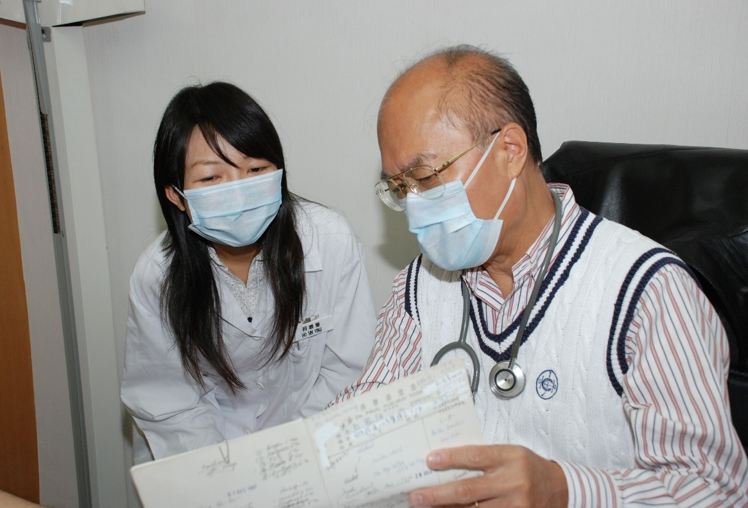
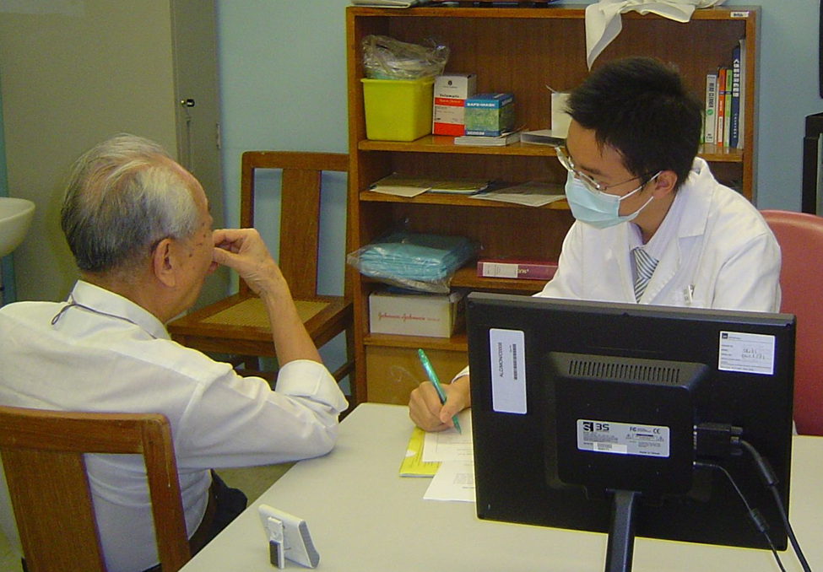
Learning
Clinical consultation Skills

Slide 3
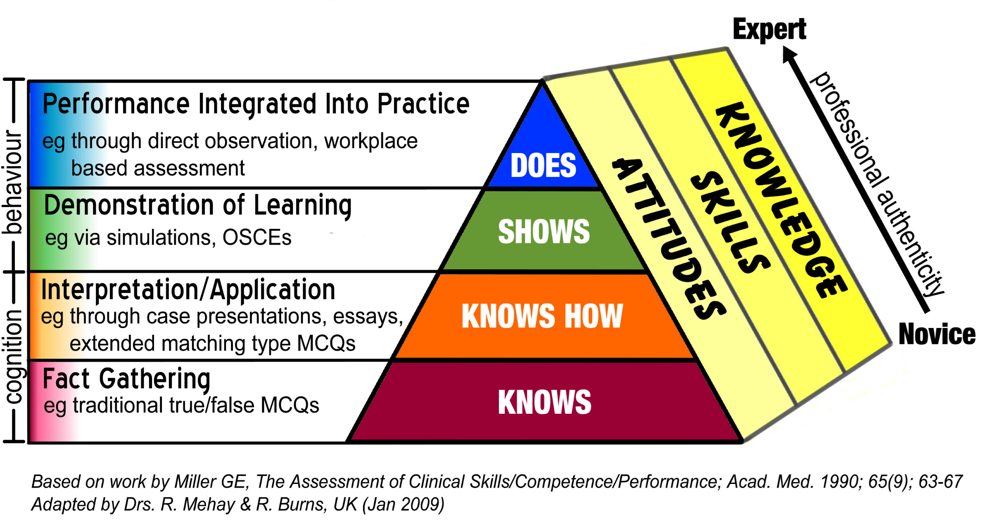
Miller’s Pyramid of Clinical competence
Simulated / Real patient consultation
Peer physical examination,
Role play
Seminar, Demonstration

Slide 4
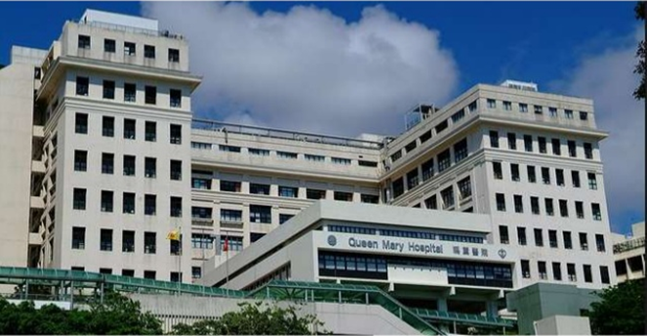
Inpatient bedside teaching:
hospital wards
Primary care teaching:
general outpatient clinics (GOPC) in the community

Slide 5
SCAFFOLDED LEARNING
OF CLINICAL CONSULTATION SKILLS
 | Miller’s pyramid of Clinical Competence | Mode of learning- Usual practice | Mode of learning- During COVID-19
Foundational skills (physical exam) | Knows/ shows how | Tutorial with demonstration and peer physical examination | Online Zoom tutorial with demonstration and interactive Q&A
Application (conducting a clinical consultation in a safe setting) | Shows | Workshop with simulated patients and clinician facilitator | Online Zoom workshop with simulated patients in breakout rooms + clinician
Application (conducting a clinical consultation in a real setting) | Shows | Bedside teaching with real patients supervised by a clinician | Webside teaching with real patients and clinician supervisor

Slide 6
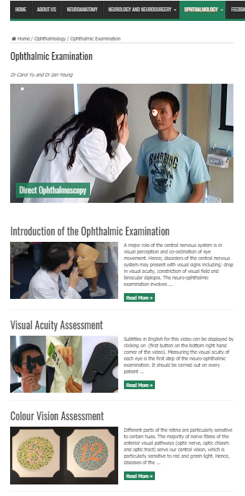
1. Foundational Skills ophthalmologic examination
A 3-pronged approach to learning:
Written information (knowledge)
Video demonstrations (skill acquisition)
Online small group tutorial (clinician reinforcement)

Slide 7
OPHTHALMOLOGIC Examination
Online tutorial: Dr Kendrick Shih

Slide 8
SCAFFOLDED LEARNING
OF CLINICAL CONSULTATION SKILLS
 | Miller’s pyramid of Clinical Competence | Mode of learning- Usual practice | Mode of learning- During COVID-19
Foundational skills (physical exam) | Knows/ shows how | Tutorial with demonstration and peer physical examination | Online Zoom tutorial with demonstration and interactive Q&A
Application (conducting a clinical consultation in a safe setting) | Shows | Workshop with simulated patients and clinician facilitator | Online Zoom workshop with simulated patients in breakout rooms + clinician
Application (conducting a clinical consultation in a real setting) | Shows | Bedside teaching with real patients supervised by a clinician | Webside teaching with real patients and clinician supervisor

Slide 9

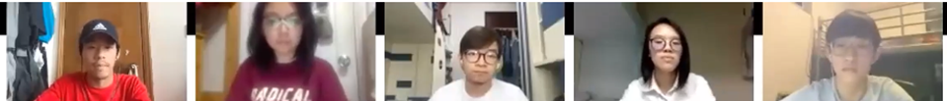
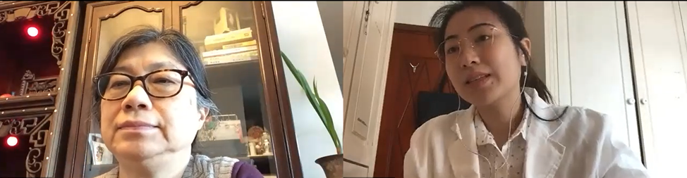
2. Conducting a Clinical consultation (Patient EDUCATORS)
Family Medicine workshop: Dr Esther Yu
Making a whole-person diagnosis
MBBS Year 4 students: 5 groups x 6-8 students
5 trained patient educators rotate to each breakout room
Student pairs interview a patient using a structured approach and appropriate communication skills to determine the diagnosis and problem list
Patient educators gives individual and collective feedback
Clinician leads discussion of clinical aspects of the case

Slide 10

CONDUCTING A CLINICAL CONSULTATION
(SIMULATED PATIENT) – the interview

Slide 11
SCAFFOLDED LEARNING
OF CLINICAL CONSULTATION SKILLS
 | Miller’s pyramid of Clinical Competence | Mode of learning- Usual practice | Mode of learning- During COVID-19
Foundational skills (physical exam) | Knows/ shows how | Tutorial with demonstration and peer physical examination | Online Zoom tutorial with demonstration and interactive Q&A
Application (conducting a clinical consultation in a safe setting) | Shows | Workshop with simulated patients and clinician facilitator | Online Zoom workshop with simulated patients in breakout rooms + clinician
Application (conducting a clinical consultation in a real setting) | Shows | Bedside teaching with real patients supervised by a clinician | Webside teaching with real patients and clinician supervisor

Slide 12
3. Conducting a Clinical consultation (real Patient): History and physical exam
Neurological clerkship: Dr Anderson Tsang

Slide 13
Case discussion with clinician

Slide 14



Lessons Learned…
It’s an opportunity
Blended learning
Keep extending!
Notes:
14

Slide 15
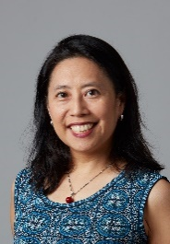
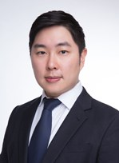
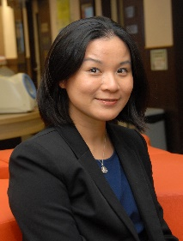
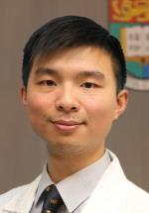
Thank YOu!
Julie Chen
juliechen@hku.hk
Dr Kendrick Shih
Department of Ophthalmology
kcshih@hku.hk
Dr Esther Yu
Department of Family Medicine and Primary Care
ytyu@hku.hk
Dr Anderson Tsang
Department of Surgery
acotsang@hku.hk
Notes:
15

