Slide 1
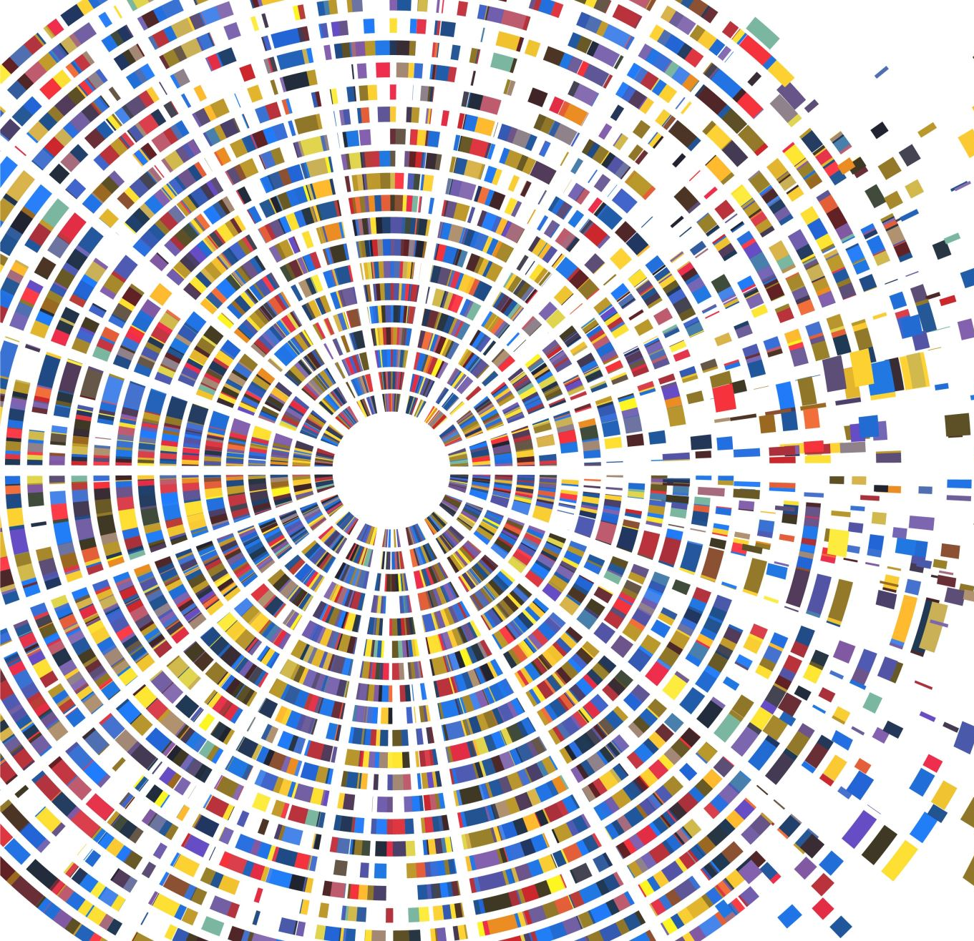
Continuing Hands-On Experience in Pandemic
Dr KS Lui & Dr Sam Lam
Department of Electrical and Electronic Engineering

Slide 2
ELEC 3848
Integrated Design Project
Core course for all students (110+ students this semester)
The ONLY core course that offers intensive hands-on experience and has a group project component
NO exam, 100% continuous assessment
One of the measurement courses for accreditation (coming Nov/Dec)

Slide 3
Original Structure of the Course
Week | Activities | Assessment
First week | Course introduction | -
Before mid-term break | 5 laboratory exercises - hands-on exercises on how to use microprocessors, electronics, sensors, motors, etc. to build simple applications | Moodle questions Task demonstrations Lab reflection
After mid-term break | Group project Automatic vehicle system https://youtu.be/9wgSnQcxc1A https://youtu.be/6uQx8ibzHe8 | Task completion (time and complexity) innovation Final report
Labs and Projects can no longer be conducted in lab! Demonstrations as well…

Slide 4
Take-home Lab Arrangement
Distribute portable lab materials
  Pickup from Departmental Office
  By mail service
Provide simulator support for simple implementation before materials are available
Video instructions
Discussion forum in Moodle for Q&A
Revise lab instructions to tailor for work-at-home where some equipment is not available
Task demonstration via video clips

Slide 5
Take-home Project Arrangement
Materials must be picked up from HKU due to safety issue
Detailed video tutorials on putting the things together
Revise project tasks for take-home situation
Individual project via simulator option available
Zoom presentation for project proposals

Slide 6
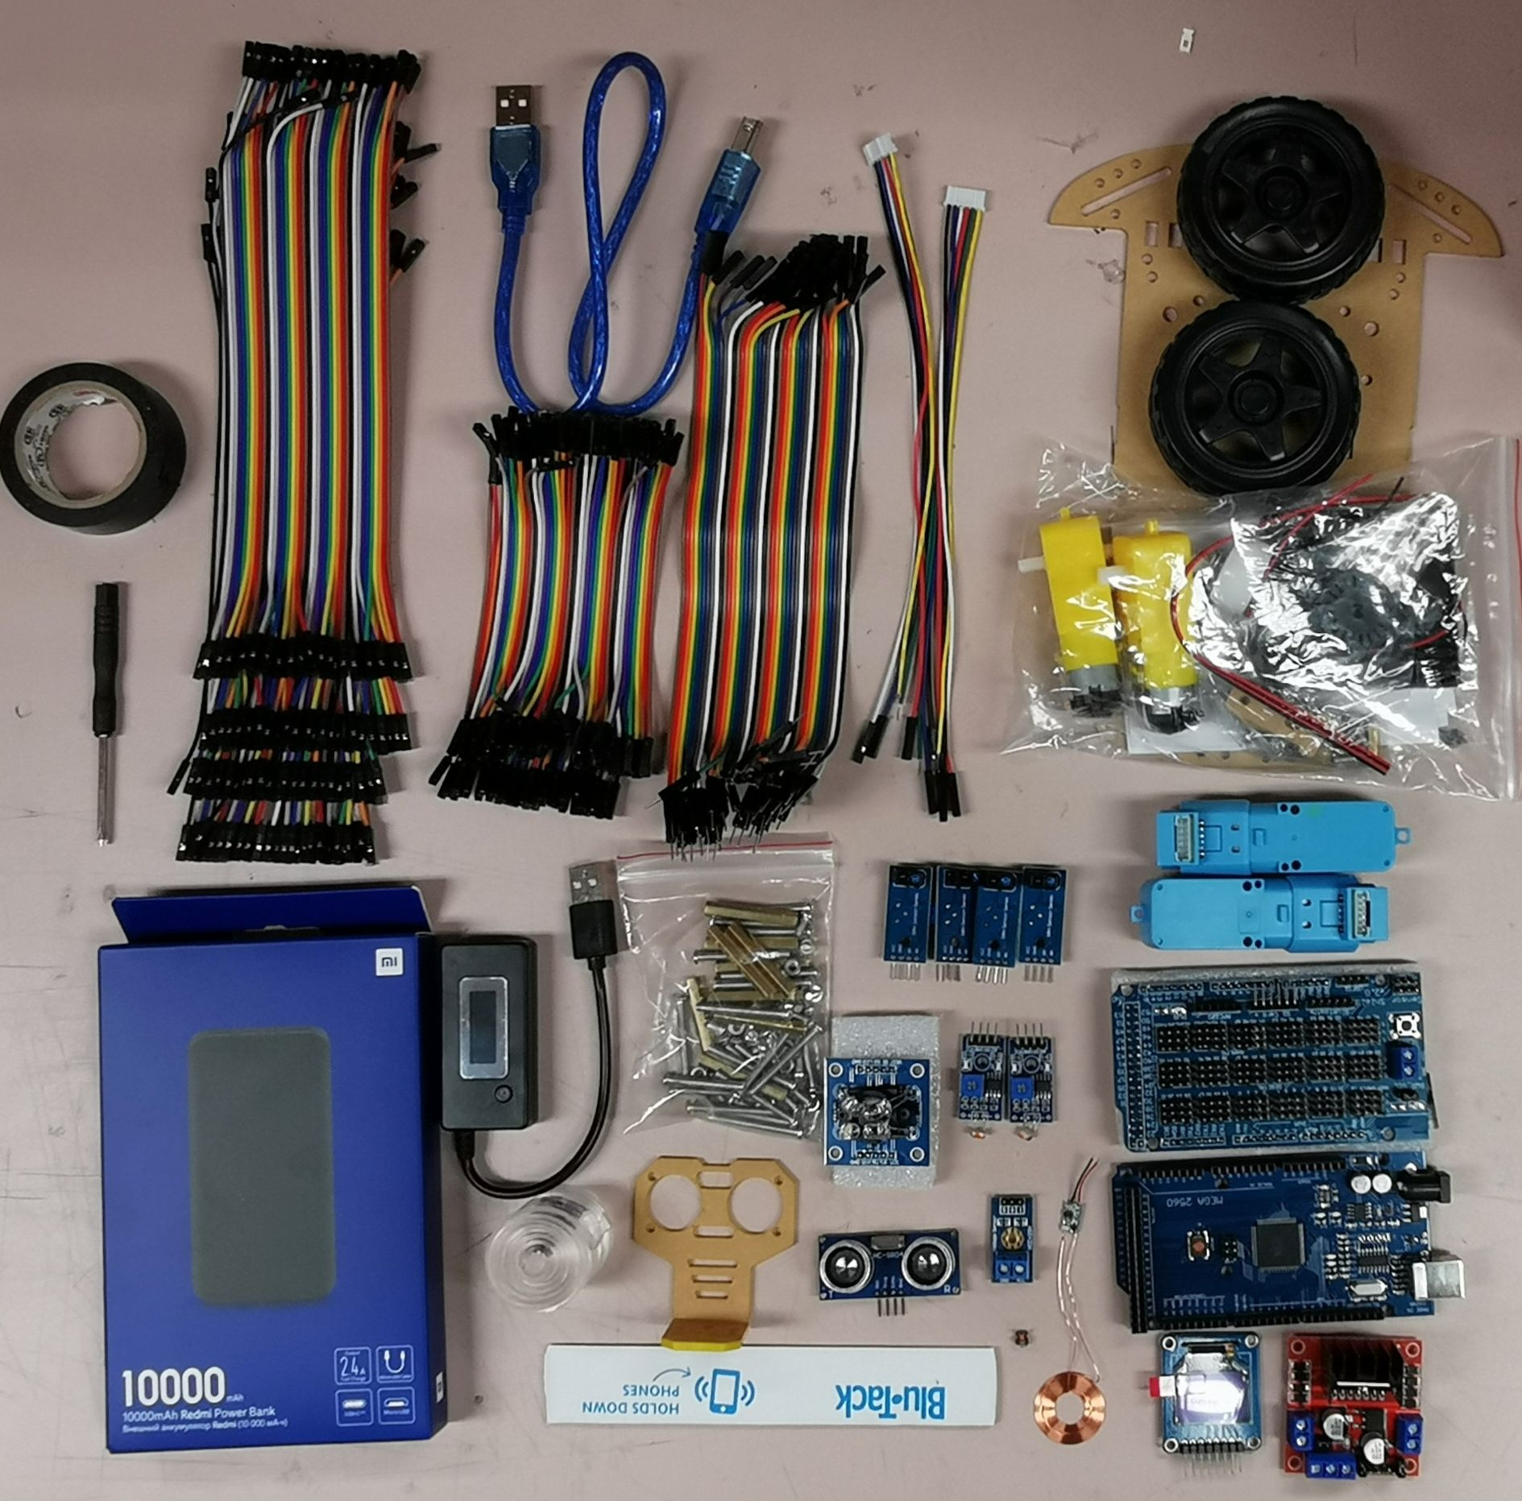

Slide 7
Take-home Project Assessment
Video clips to demonstrate functionalities of the vehicle system
  Time performance: stop watch
Narration required to explain the design principle
Final report can be developed as before

Slide 8
Conclusions
Major elements of the course are successfully kept
Transition was easier by e-learning & flipped classroom adoption
Students are comfortable with multimedia forms of learning materials

