Slide 1

Half-day Virtual Forum
Outline T&L 2019-20 The HKU Experience
(11
CCHU9001 (2019-20)
An Experiment in
Authentic Digital Assessment
Mathew PRYOR
(Lynn H.Y.N. LIN)

Slide 2
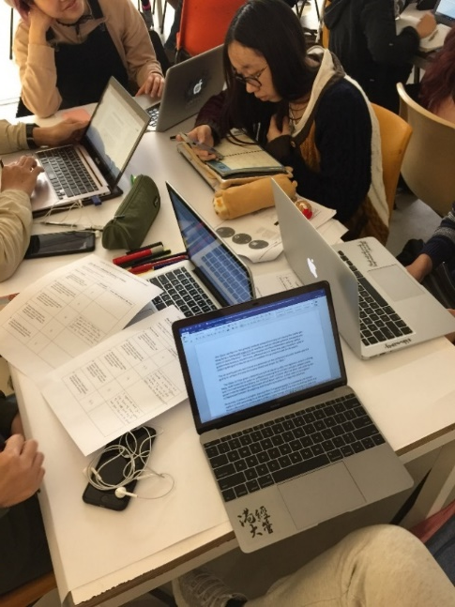
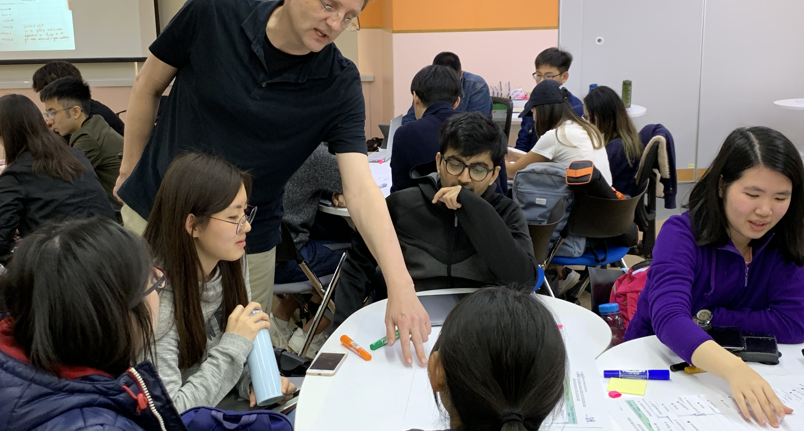
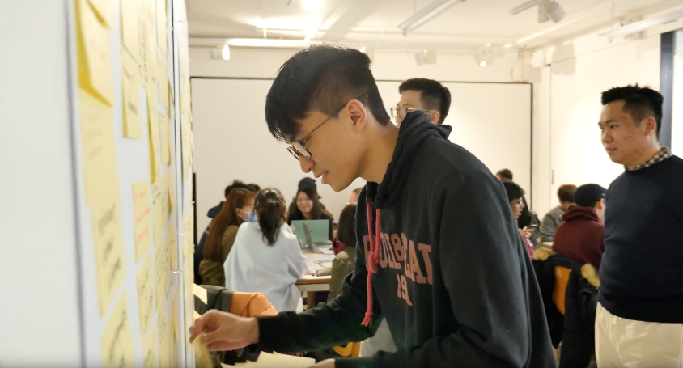
Designs on the Future : Sustainability of the Built Environment
CCHU9001 (Sem2, 19-20)
Mathew Pryor (DivLA) – Course instructor
Lynn Lin (SRA) – Platform design & development
Tyrone Kwok (TELi) – Platform coding
Ma Muye (M.Arch) – 3D modelling
Monica Chong (TA) - Tutor
Ellena Wong (TA) - Tutor
Silvia Chang (TA) – Tutor
Sharon Keung (TELi) – Course tech support
Class of 2019-20 (102 - incl. 4 R4U students)

Slide 3

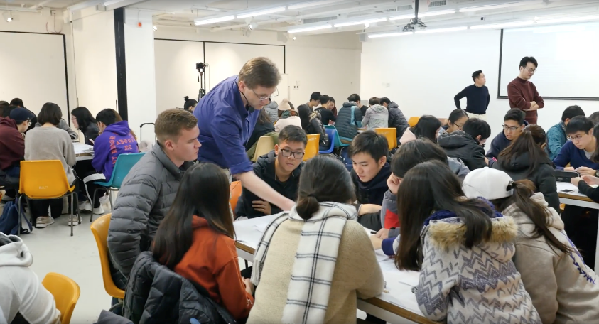
Learning Objectives
Knowledge Sustainability principles framed around issues of the UN’s SDGs, as they relate to Hong Kong.
Skills Argumentation / advocacy - making the case in a complex (and post-factual) world.
Last Year ....

Slide 4


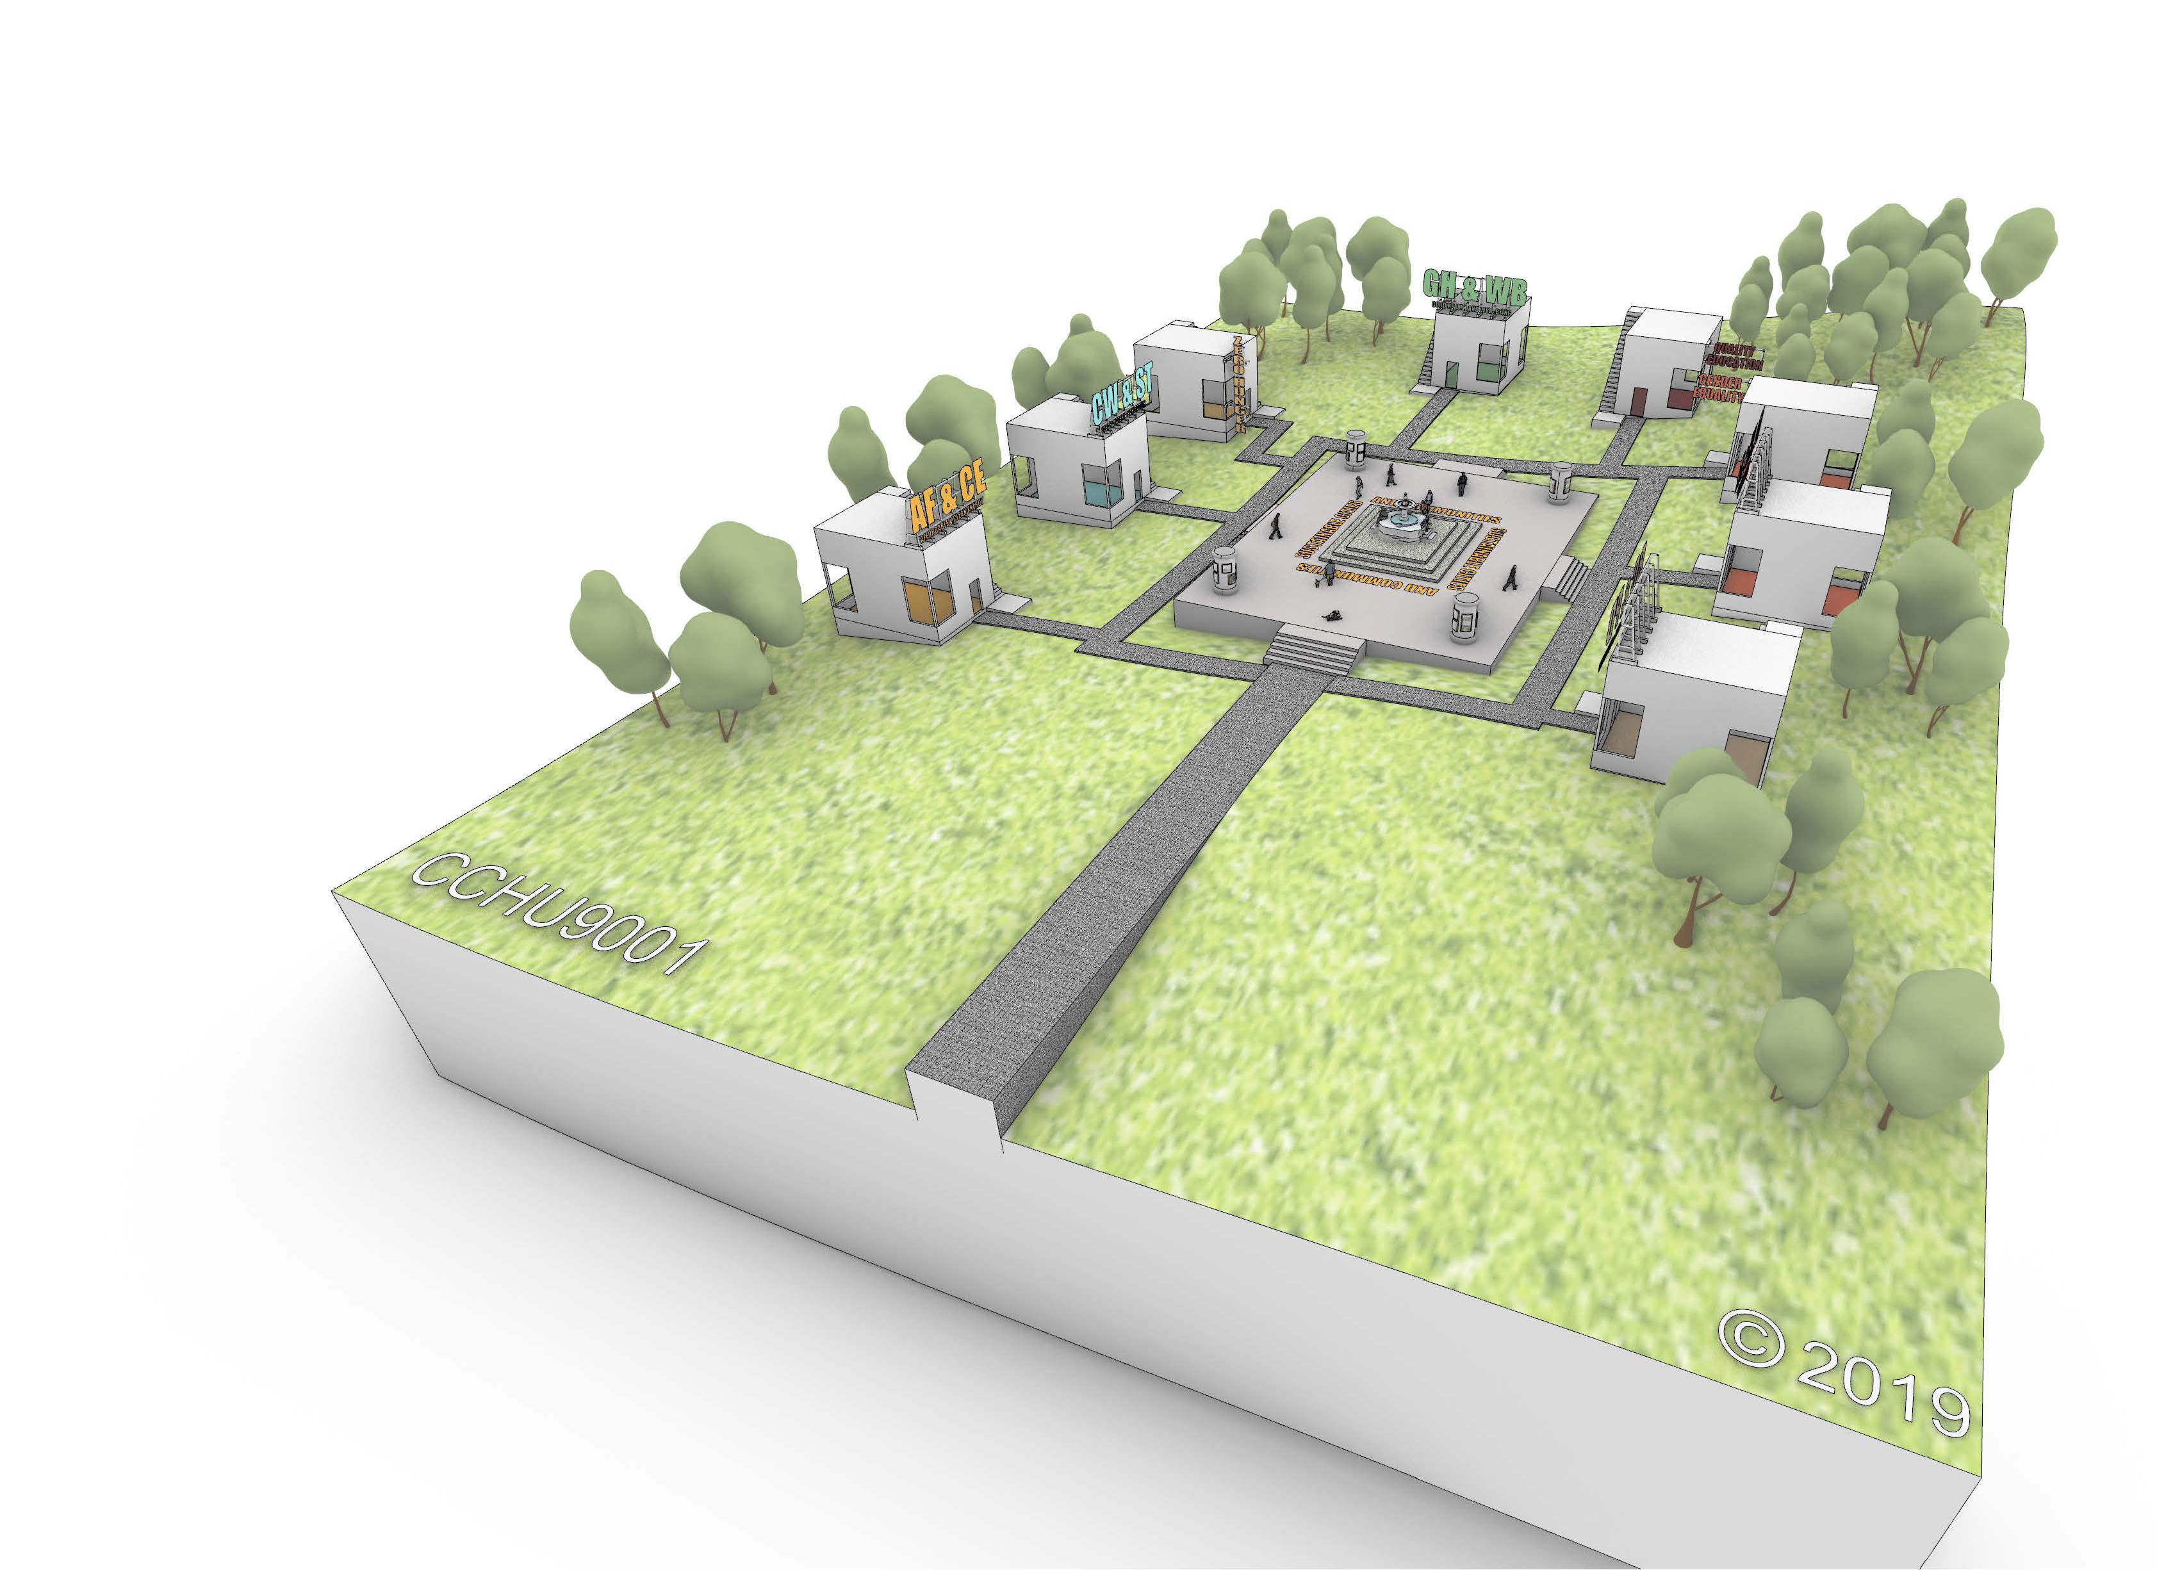


Now (all) online
Further development of the course within its flipped class format, in 2020, course was adapted to run 100% online.
Course run using edX + Google docs + new Digital Exhibition Space (DES), with some other platforms (Padlet, Menti, etc.)
Digital Exhibition Space (DES)

Slide 5
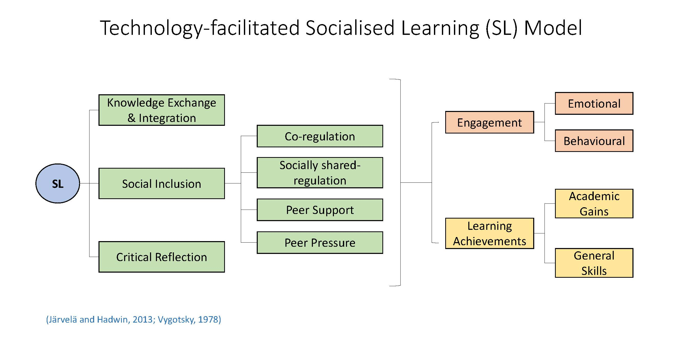
Socialised Learning
Opportunity to further develop and test ideas generated through our Socialized Learning Model (SL) pioneered last year
(Lin HYN & Pryor M, 2019)

Slide 6
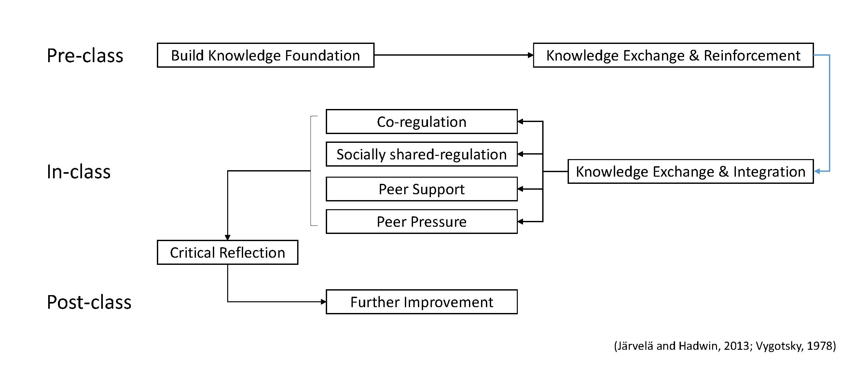
Socialised Learning in a Flipped Class
Focus on peer-supported learning on-line, i.e. facilitating students’ regulated learning
(Lin HYN & Pryor M, 2019)

Slide 7
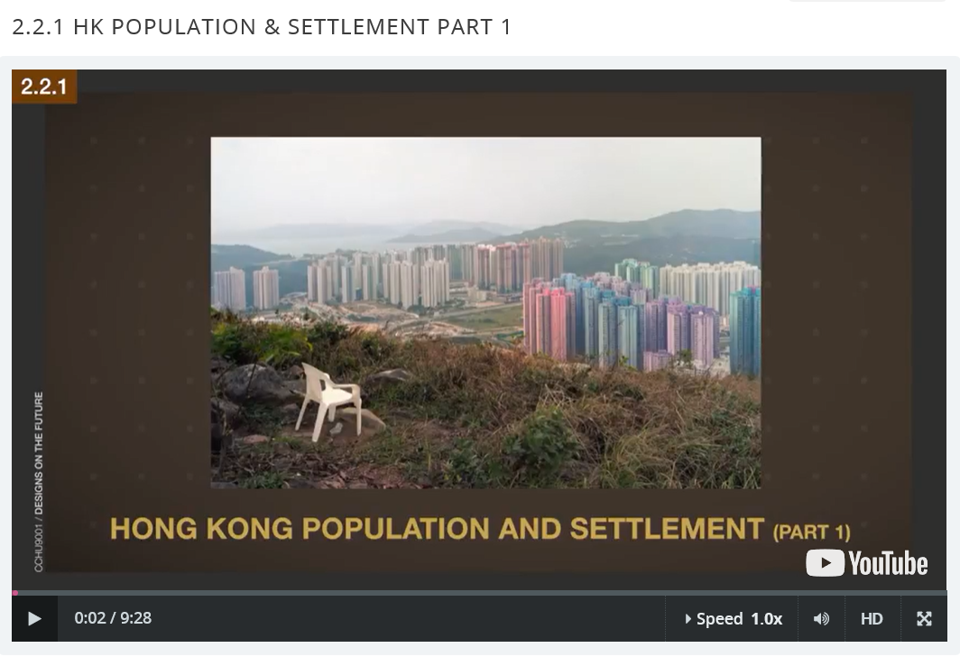
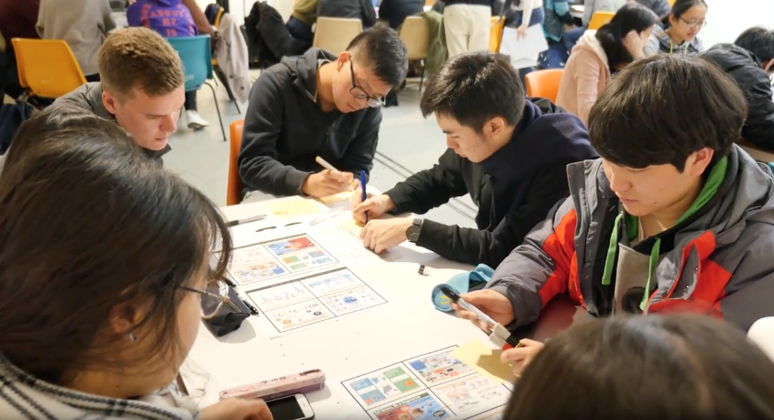
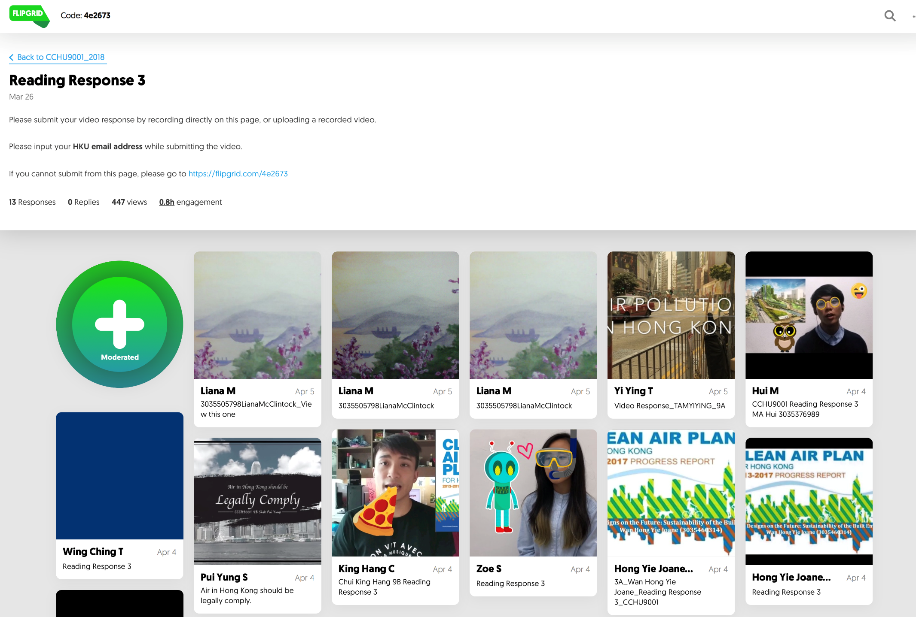
CCHU9001 - Revised structure
Two introductory session - framing key questions
  Pre-class video presentation + Zoom tutorial discussions
Four topic sessions - introducing the key sustainability issues
  Pre-class video presentation + quizzes + Zoom tutorial discussions / activities
Three skills sessions - focus on coursework activities
  Digital Exhibition Space (DES) + Zoom tutorial discussions / activities
Three sharing sessions – learning from each other
  Digital Exhibition Space (DES) + Zoom tutorial discussion

Slide 8
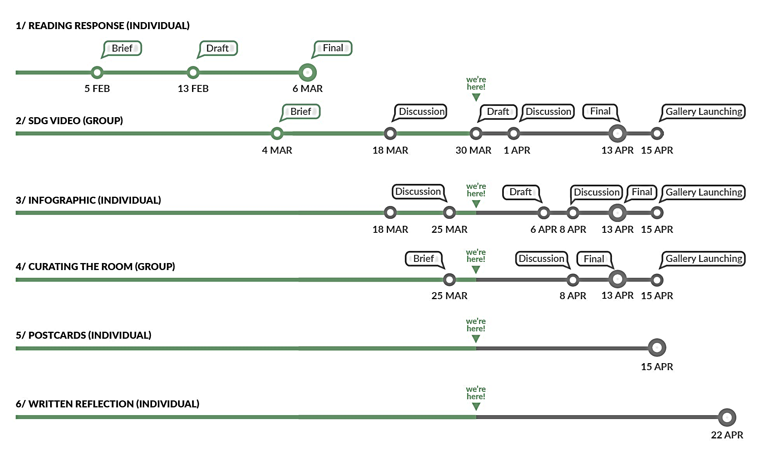
Coursework vs Assignments
Coursework Formative non-graded exercises and activities to prepare for assignments
  [pre-class video, with simple task / quizzes + tutorial discussions and activities]
Assignments Graded individual and group tasks, with feedback (via instructor and peers) on drafts (chances for revision up to the end of the course)
[pre-class + tutorial discussions + peer review via DES]

Slide 9
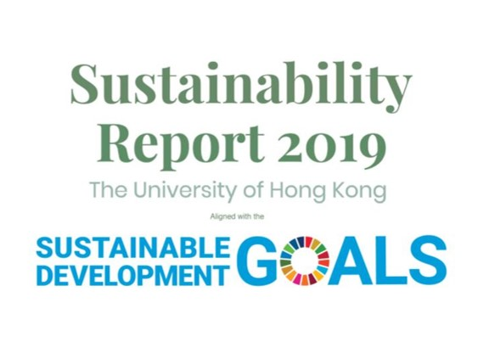
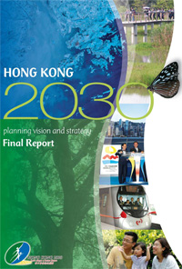
Authentic Assessment
Course asks students to interpret and translate the UN’s Sustainable Development Goals (global scale) to a known territorial scale (Hong Kong), and in reference to HKU’s own initiative (personal scale).
Global
Territorial
Local

Slide 10
Assignments
Assignments |  | Collaboration*
Written Reading Response (200 words) | (10%) | Type 1
Explanatory video for your SDG as it relates to Hong Kong (3 mins) highlighting core issues, key voices, organisations, current initiatives, etc., to explain why your SDG is important | (30%) | Type 4
Making an infographic diagram to advocate some position related to your SDG | (20%) | Type 1
Curating the group’s room, uploading content and any possible add-ons (visitor quiz, case studies, bibliographies, personal stories etc.) | (10%) | Type 3
Postcards (4 no.) 100 word comments / suggestions for four other SDG rooms | (20%) | Type 1
Written reflection – how does your SDG relate / contribute to the whole idea of a sustainable future? (200 words) | (10%) | Type 1
Collaboration Type
1 Individual assignment (prescribed scope - everyone does the same)
2 Group assignment (prescribed scope - group allocates tasks and agrees outputs)
3 Group assignment (prescribed scope - group undertakes tasks together)
4 Group / individual assignment (self selected scope - group allocates tasks and agrees outputs)

Slide 11
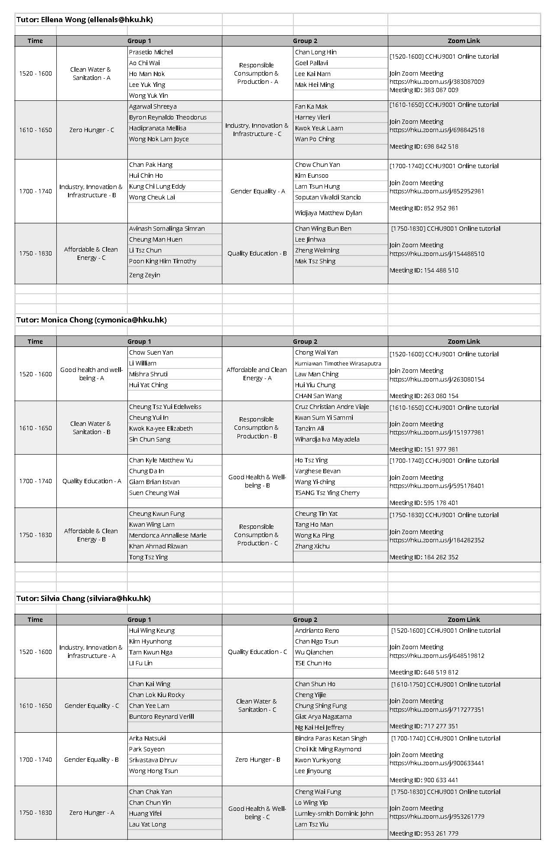
Group structure
From week 3, (add/drop) students work in mixed groups of 4 (for the whole semester).
Each group assigned one of eight selected SDGs, and tasked to research and present as it, as it relates to the territory of Hong Kong (single overall course project, composed on several small assignments)

Slide 12
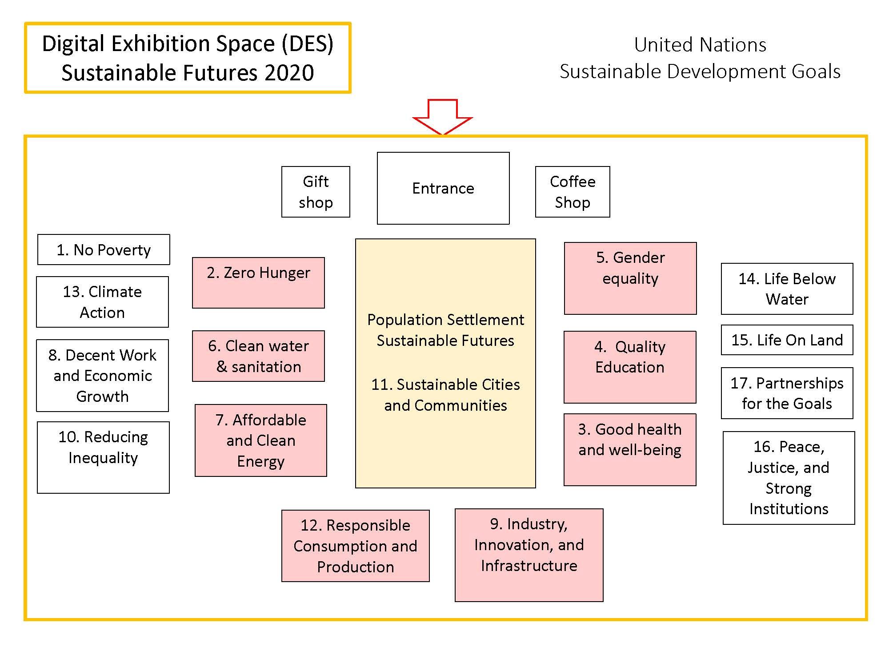
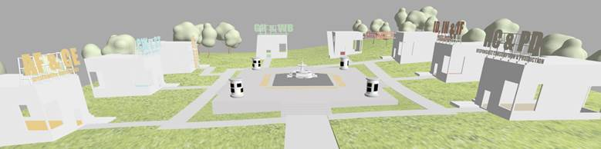
Digital Exhibition Space (DES)
Purpose-made online platform for students to:
Share and present their coursework and assignments
Collaborate, regulate and visually track learning progress
Review and give feedback to other students, and reflect on own perspective (of the SDGs)
Communicate with the outside world.
DES can take any form ... in this course we used an expositional form with 8 SDG galleries spaced around a central thematic plaza.
https://learning.hku.hk/cchu9001/DigitalExhibitionSpace/app/web/
Platform Hosted by HKU Online

Slide 13
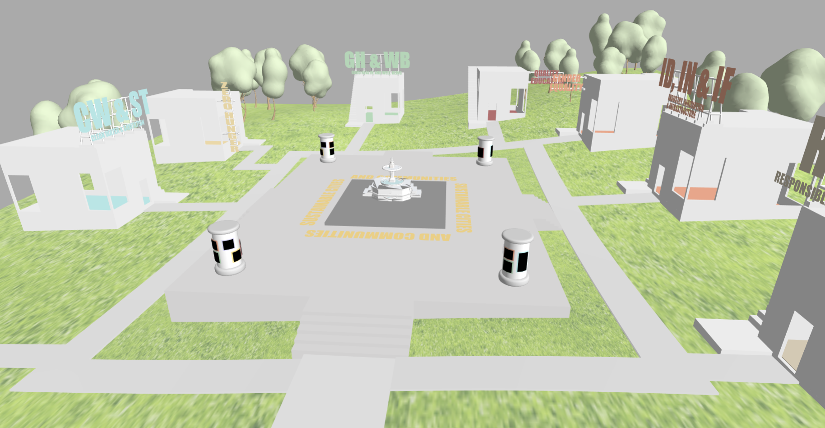
CCHU9001 Digital Exhibition Space

Slide 14
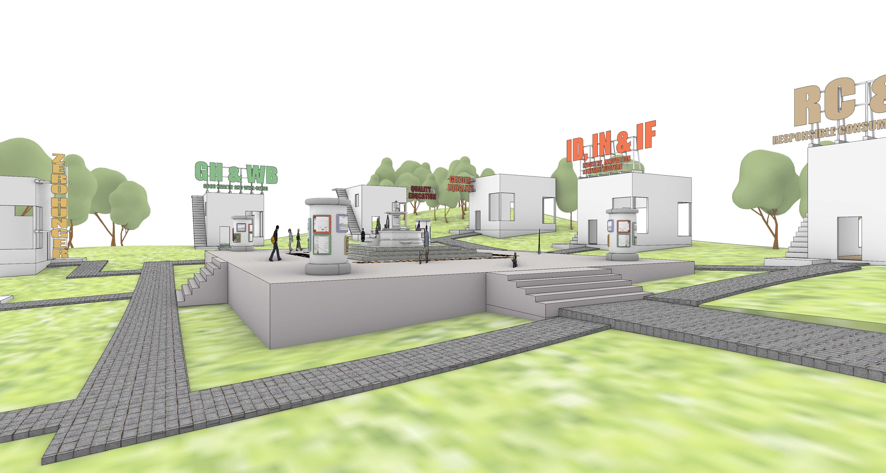
Central Plaza
Central space used for instructors to upload course information, content (e.g. course videos), assignment briefs, general principles (in parallel to edX) and to present the overarching theme – sustainable Cities and Communities

Slide 15
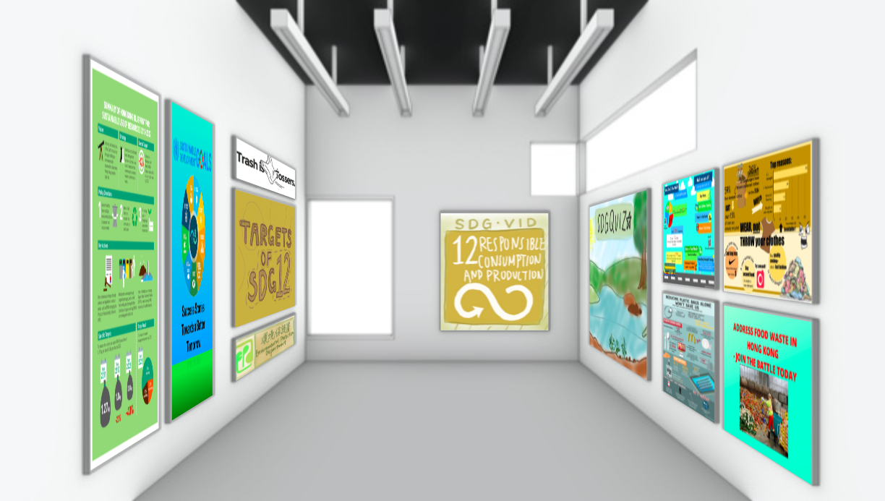
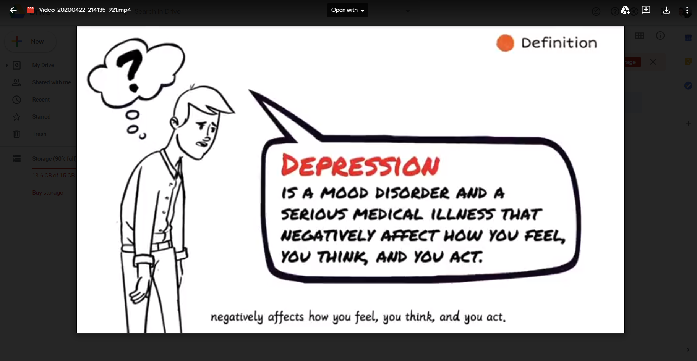
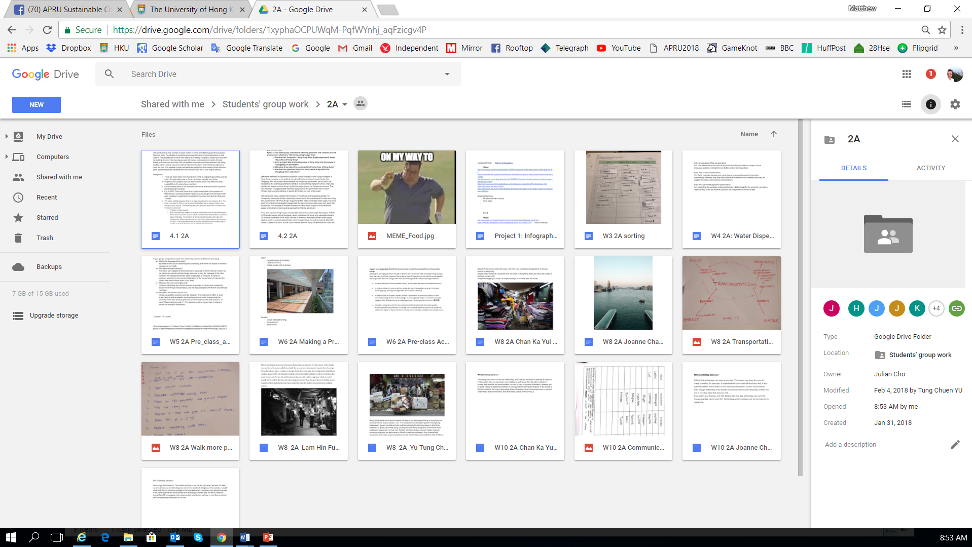
SDG Galleries
Students upload their assignments (video, reading responses, infographics,) and other chosen elements (images, visitor quizzes, bibliographies etc) as artefacts.
The group curates and then publishes their gallery – allowing access to other students to learn from their work, and give feedback on it.
DES has now been shared with the public (can be viewed now)
Student Learning Festival – Wed, 13 May

Slide 16
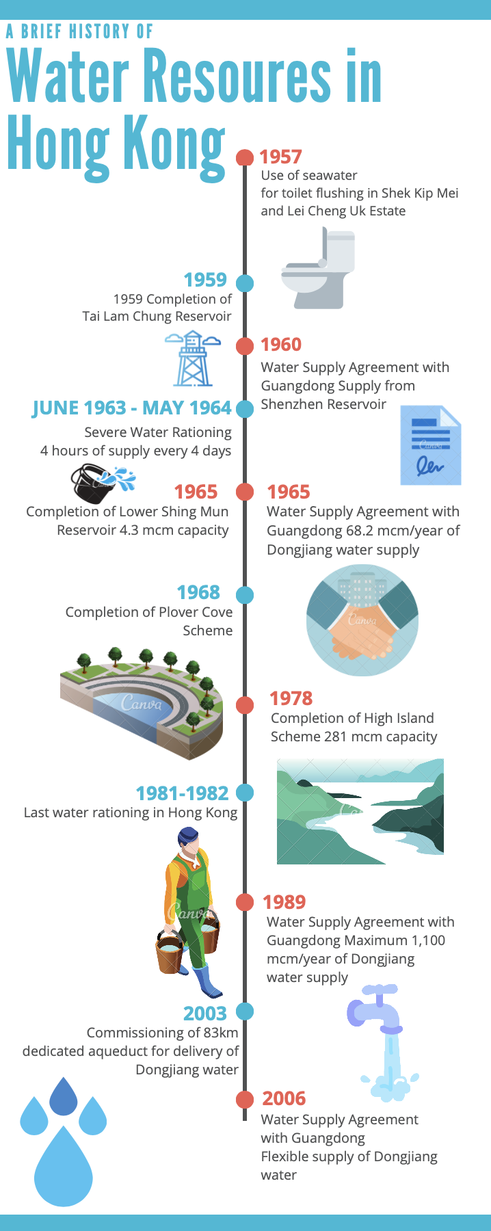
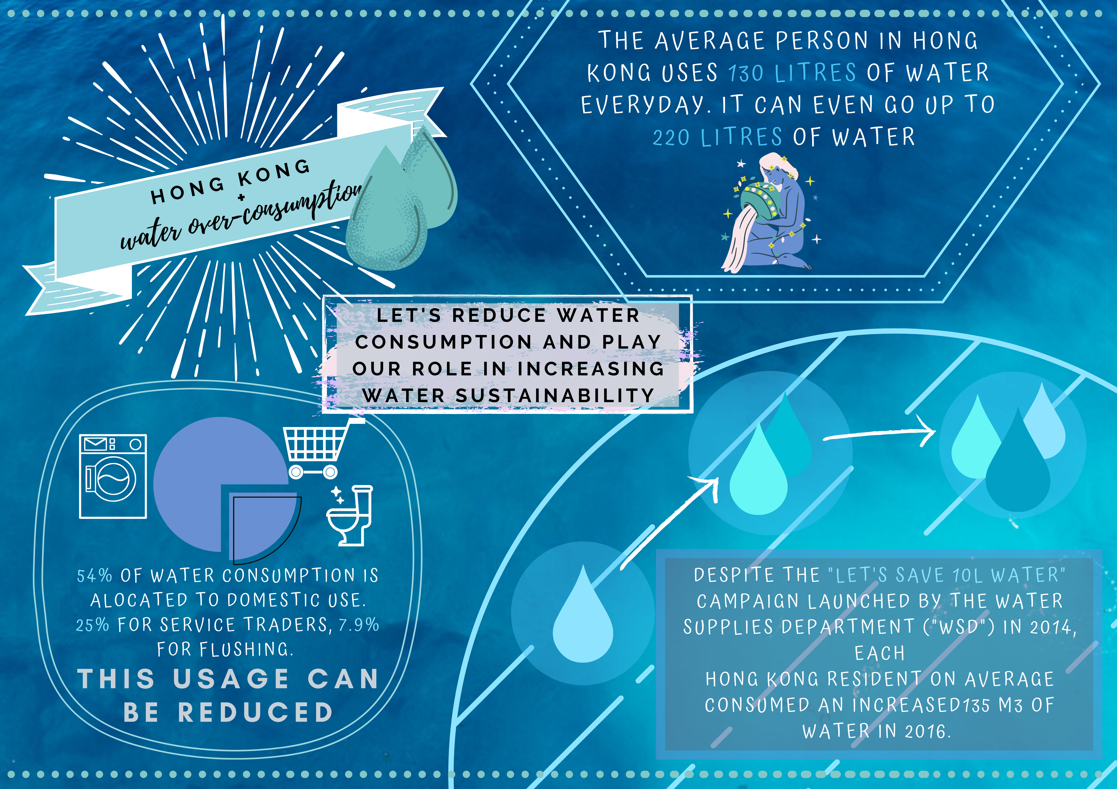
Student Work
Clean Water & Sanitation (A)
Infographic diagrams
Timelines
Case Studies

Slide 17
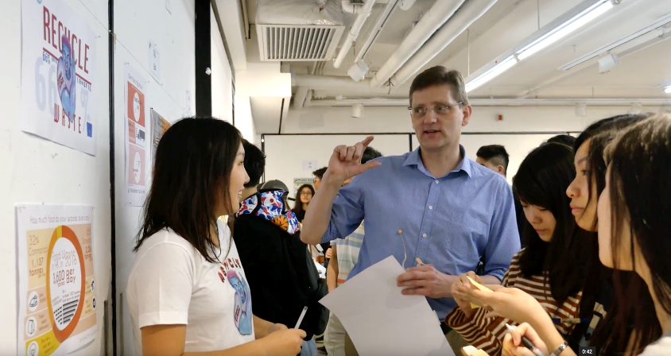
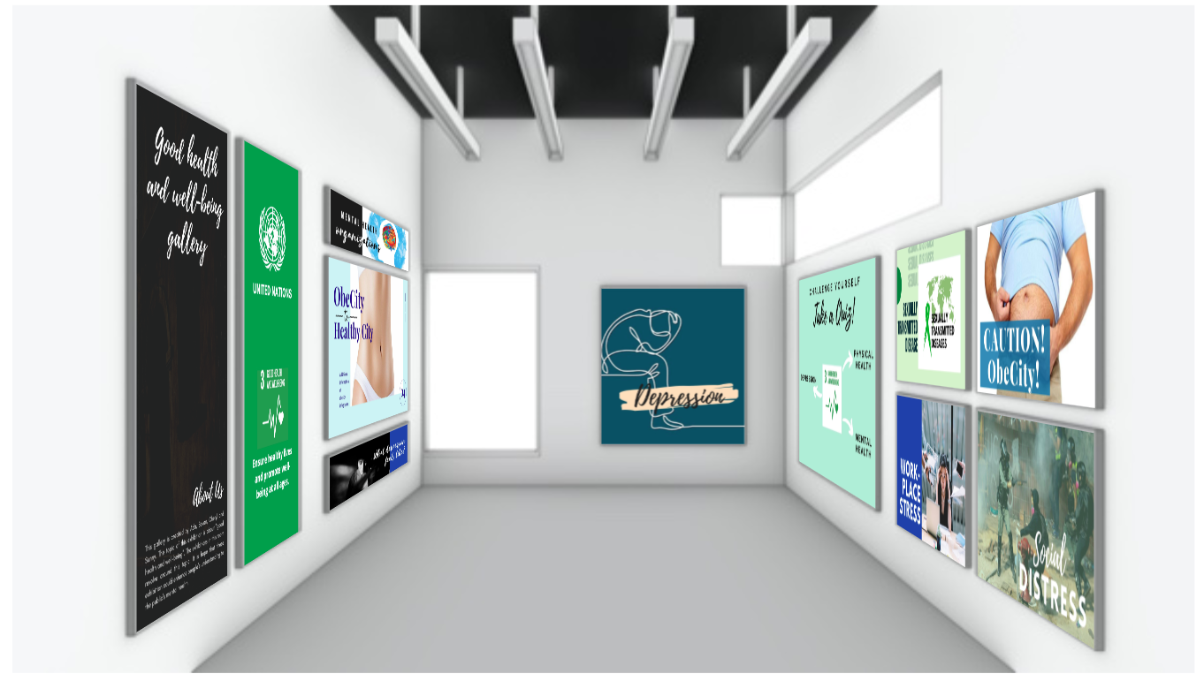
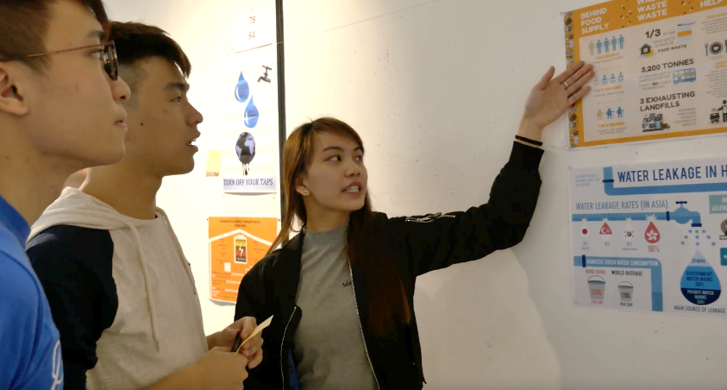
Digital Learning Environment
A 3D environment which facilitates an instructional design that promotes students sharing their assignment work with each other as a way of learning and demonstrating knowledge / skills acquired.
DES allows .........
....... this to happen online

Slide 18
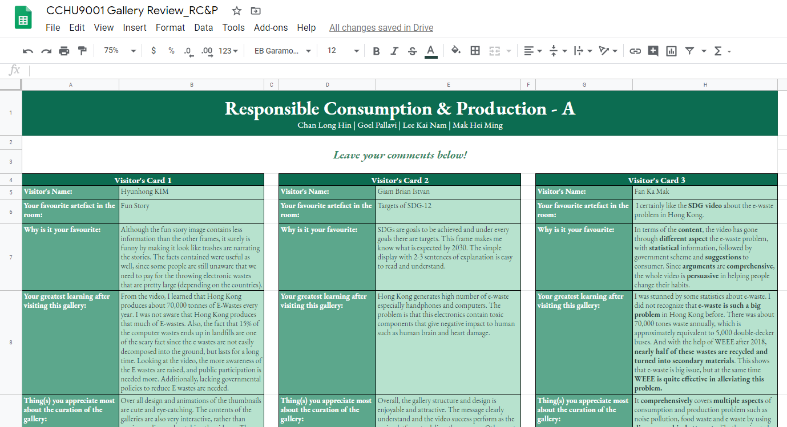
Sharing
Last two course assignments require students to:
visit and leave substantive comments on four other galleries, and
reflect on how the galleries combine to achieve a Sustainable City / Community

Slide 19
Student feedback on use of DES
Very positive response on engagement and student interaction.
“I believe that it is a great platform to educate people about all the SDGs as it displays all the information about them and also tells the people how they can help in their attainment. Suggest adding a chart to show the dependence of all SDGs on other SDGs.”
SRIVASTAVA Dhruv 3035667792
“The Digital Exhibition Space provides interactive ways for people understanding SDGs, especially when videos and infographics can visualize SDGs, transforming abstract concepts into real-life experiences. It would be great if different SDG rooms collaborate on an artifact in central-plaza, visioning the sustainable future with all SDGs implemented.”
NG Kai Hei Jeffrey 3035698258
“The whole picture of SDG can be easily understood because the data of the topic have been integrated and put into point form and the page of useful link can provide a deeper understanding. The only fly in the ointment is that the diagram at two sides cannot be easily seen.”
LAM Tsun Hung 3035699642

Slide 20
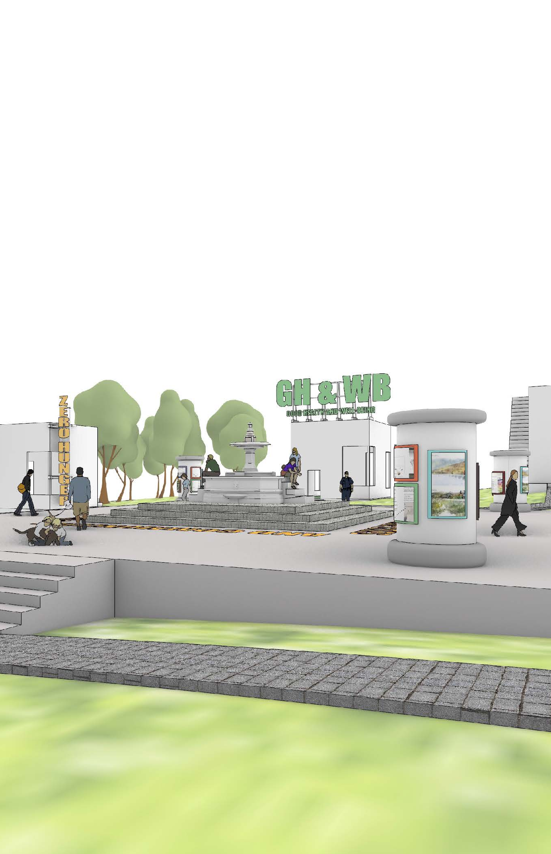
Summary of comments
Small tasks build to a common project.
Collaborative (regulated learning).
Different forms of group work (esp. negotiated)
Low-level competitive (peer oversight).
Learn from others / self-assessment against others.
Instructor feedback on drafts allows students to improve and re-submit work
Discussion of all assignment drafts in tutorials generates useful feedback.
Mode of assessment focused on learning rather than on format (both formative + summative).
Fun, informal, easy to use.
Authentic (even online) – focus on SDGs in HK helps relate to real-world situations.

Slide 21
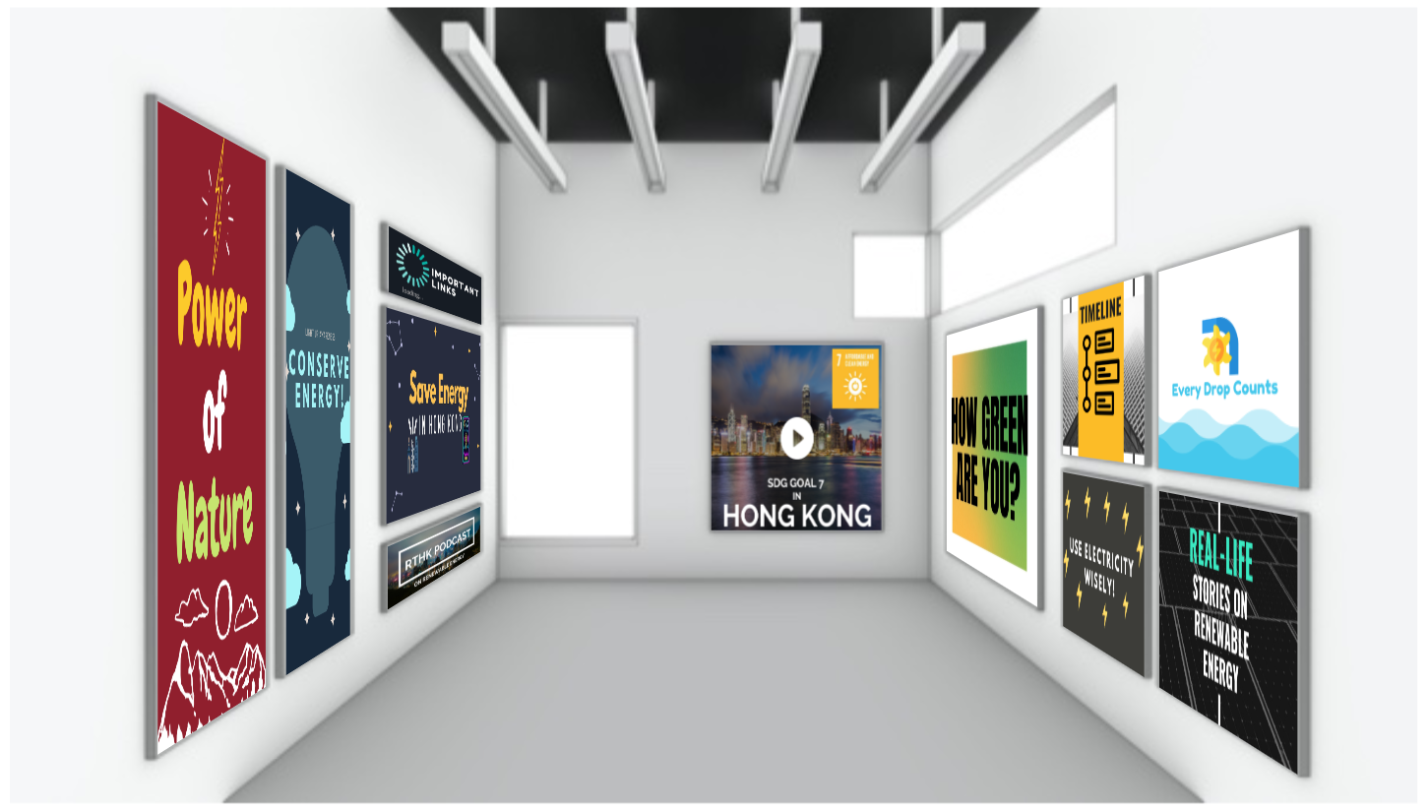
Next
The platform is a basic prototype, but easy to use and well received by students.
It can take any form (e.g. an interior building space) ... coding can be easily adapted,
.. and applied at any level.
Now ... looking for funding to develop it and text it within different courses.
Affordable & Clean Energy (B)

Slide 22
Half-day Virtual Forum
Outline T&L 2019-20 The HKU Experience
(11
CCHU9001 (2019-20)
An Experiment in
Authentic Digital Assessment
Mathew PRYOR
(Lynn H.Y.N. LIN)

