Slide 1
Learning Design for an Uncertain Semester
Dr Helen King
NTF PFHEA SFSEDA
Deputy Director (Academic Development)
Academic Practice Directorate
https://www.uwe.ac.uk/
helen5.king@uwe.ac.uk
@drhelenking
Education 4.0
13 August 2020
Notes:
Introduction:
Rather than talk you through everything our University has been doing, I am going to focus particularly on faculty development, the key issues and how we are supporting staff to address these.
I intend to spend 20-25 minutes on the presentation so that there will be plenty of time for questions and for you to share your ideas and experiences.

Slide 2



Context: teaching ranking & reputation
Notes:
The obligatory rankings slide. If you are interested in this type of data then more information is available on our website. I have selected 6 items to highlight here.
The first three indicate our focus on and commitment to a high quality student learning experience.
The second set are indicators of our primary mission to

Slide 3
Context: the University and its students
Practice-led: courses created in partnership with industry professionals
Values = Graduate Attributes:
  Ambitious, Inclusive, Innovative, Collaborative, Enterprising
Demographics:
  >30, 000 students across three campuses (~2/3 full-time)
  ~2/3 UG, 1/3 PG (including ~500 PGR)
  ~4, 500 international (EU + overseas) students
  ~1, 500 teaching staff (faculty)
Notes:
Courses range from more traditional academic disciplines such as maths and history, to highly skilled professions such as law and paramedic science, as well as the arts and creative industries.
We encourage and enable our students to develop capabilities beyond their subject or discipline in order to become active global citizens. Hence, we have aligned our Graduate Attributes to our University values.
We have over 30, 000 students, of which approximately 2/3 are full-time. And approximately 2/3 are undergraduates, the remainder being Postgraduates including approximately 500 postgraduate research students.
Our students are from a wide range of academic and socio-economic backgrounds including coming straight from high school and older students who have had a break in learning or are looking to upskill.
Similarly our teaching staff have a range of academic and professional experience; some having come through a traditional PhD to lecturing academic route. Others who have worked in professional practice for many years before sharing their experience through teaching.

Slide 4
Context: the UK academic year & Covid-19
March 23rd = lock down, 2 -3 weeks before end of teaching
April – May = assessment period
June – July = marking & exam boards
August – September = preparation for next academic year / annual leave
September / October = teaching starts in new academic year, on-campus (socially-distanced) & online
Notes:
At UWE, all our undergraduate courses will be starting in September / October, but most of our taught postgraduate courses will have a delayed start in January.
So, of course, planning for the new academic year is a complex process involving not only teaching staff but estates & facilities, public transport & car parking, student accommodation etc. But, for this seminar, I’m going to focus on some of the key issues for curriculum design from the teacher perspective.

Slide 5
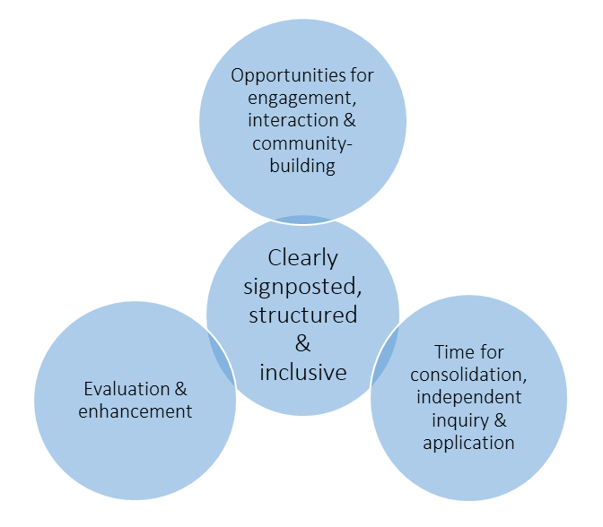
Issue No. 1: consistency of guidance
Wide variety of support & advice available
Need to ensure consistent approach to learning
Uwe 4 Principles of Learning
Design
Notes:
The majority of our digital education support is based out within the four University Faculties, with only a very small resource available in the centre (within the Academic Practice Directorate). There are also a variety of UK & wider networks and organisations sharing resources and ideas (such as SEDA and Advance HE in the UK). And of course colleagues share practice with each other. This is also very positive have we have received feedback from the Faculties that they feel well-supported. However, we need to be aware of ensuring some consistency of approach across the University, to ensure a coherent student experience; and we were aware of some ‘mythologies’ developing where rumours or speculations get shared as fact (e.g. in one Faculty – you have to produce videos for all your lectures, no live broadcasting).
Developed University principles of learning design – mapped to pedagogically good practice – produced general guidance and resources on a website, and run regular webinar workshops.

Slide 6
Issue No. 2: planning for uncertainty
https://bit.ly/UWEdesign
On-line and on-campus learning
Inclusivity
Timetabled learning = engagement, interaction & community-building
    Lectures on-line with ‘chunked’ activities
Non-timetabled learning = consolidation, independent enquiry & application
Clearly communicated learning structure & expectations
Ongoing evaluation & enhancement
Notes:
We are normally teach the vast majority of our classes on-campus / in person, with only a very small number of courses solely online. Colleagues then need to adapt their teaching for delivery large classes online (synchronous or asynchronous), with some specialist teaching e.g. labs, simulations suites etc. on campus. With the added uncertainty of a local or national lockdown at any time.
Colleagues were finding it difficult to conceptualise what the curriculum delivery might look like, and hence how to plan / adapt for it.
So we tried to find ways to keep it analogous to their previous ‘normal’ approach, by dividing the curriculum delivery into timetabled and non-timetabled activities.
This is one of the slides from our learning design workshop which summarises our brief (and simple) guidance. The PowerPoint from this workshop and one page overview document can be downloaded from that link.
The workshops have been positively received and have given people the confidence to be more creative about their session planning.

Slide 7
Issue No. 3: workloads
Build on existing materials & resources
Keeping it simple (technology) e.g.
  VLE (Blackboard: includes Collaborate webinar)
  e-portfolio (PebblePad)
  Quizzes / polling (Mentimeter)
  Video conferencing / file sharing (MS Teams)
  Event capture & videoing (Panopto, MS PowerPoint)
Community of practice sharing events
Opportunities to practise (informal & formal)
Notes:
Perhaps the biggest concern (after issues of connectivity and bandwidth) is that of workload and the time needed to prepare for delivery in September / October. Whilst we can’t deny that colleagues will probably need to spend more time than they usually would preparing for the new semester, we are keen to assure them that they aren’t starting from scratch. They can build on all their existing materials and resources, but will need to be a bit more organised, structured and explicit in the information they give to students e.g. structured VLE, clear guidance on learning activities, thought-through session plans.
Some colleagues are very au fait with digital learning technologies and are able to include a wide variety of tools. However, many are not that comfortable working with technology or perhaps have a more limited repertoire. As Harriet mentioned in her seminar on Monday, it’s the pedagogy that’s important, the technology is merely a tool to support it. The quality of the learning experience is more important than the ‘whizziness’ of the technology. So we recommend that colleagues stick to the small range of tools that are supported by the University – this means that support is available should something go wrong and we know the tool is robust from a data protection and security perspective.
As well as development workshops, we have also provided a few opportunities for colleagues to share their ideas or check them with each. And, as well as these which are University-wide, there are also a range of other informal gatherings taking place within Departments and Faculties to enable sharing and mutual reassurance and support.
We also recommend that they practise any synchronous activities e.g. go into Collaborate on their own or with a colleague / friend / family member and play with the tools. More formally, ‘Block 0’ is an opportunity to interact with students in a lower stakes environment.

Slide 8
‘Block Zero’
3 x 11 week teaching blocks throughout the year
  Block zero: 21 September 2020 – 16 October 2020
  Block one: 19 October 2020 – 22 January 2021
New Block Zero: structured activities to connect students to each other, course teams and the wider university in a low risk environment, where they're free to experiment with new technologies, enhance their digital capabilities and build the confidence to succeed whether online or face-to-face.
Centrally-timetabled / unified structure; common activities
Flexibility for course teams
Notes:
The academic year has been restructured in three, eleven-week teaching blocks introduced by a ‘Block Zero’. Upcoming dates are as follows with four weeks of block zero.
Purpose is to connect students together with each other, with their course teams and with the wider University facilities and activities. Particularly important for new students, but also for returning students to reconnect after the long summer period.
The overall structure for Block Zero is centrally-timetabled, so the students know where they are supposed to be and what is going on, and there will be a number of bookable and drop-in activities available to all. Course teams are given a broad framework to help them structure their contribution but they can use their time flexibly to best introduce themselves, their subject area and course to their students.
Particularly important for staff and students is that this is a low risk environment. They can experiment with the technology and get to know it together, appreciate the limitations and learn how to manage any hitches. So that when they start the full teaching in October students will already have a really good sense of how things work, what their subject area is broadly about, the expectations of them, support available etc; and staff will feel more comfortable in the mixed on-campus and digital environments.

Slide 9
Issue No. 4: student partnership
Regular ongoing contact with students
Questionnaires (Students’ Union, academic Departments)
Student Consultation Panel
Notes:
Because of the timing – students being busy with assessments and now in the holiday period – it has perhaps been a bit more difficult to ensure effective student partnership in the development of teaching for next semester.
Lecturers have been in touch with their students on a regular basis and early on, after the pivot, a number of questionnaires were circulated to gather feedback on the student experience. Student Union officers have been involved in the relevant working groups. Perhaps most effectively though, a student consultation panel was set up – all students invited to join and about 150 signed up. The panel is available to any of the working groups to share ideas and get feedback; for example the Teaching & Assessment working group consulted with them in the development of the learning design principles. Mostly this has worked through online focus groups drawn from the wider pool, and they are always over-subscribed. Looking to continue using this as a model to complement our existing student representation system and better support student partnership and co-creation.

Slide 10
Learning Design for an Uncertain Semester
Any questions or ideas & experiences to share?
Dr Helen King
NTF PFHEA SFSEDA
Deputy Director (Academic Development)
Academic Practice Directorate
helen5.king@uwe.ac.uk
@drhelenking
Education 4.0
13 August 2020
Notes:
Introduction:
Rather than talk you through everything our University has been doing, I am going to focus particularly on faculty development, the key issues and how we are supporting staff to address these.
I intend to spend 20-25 minutes on the presentation so that there will be plenty of time for questions and for you to share your ideas and experiences.

